Slide 1
Reflective Practice in Research Undertaken Multilingually
Mariam Attia
BAAL 2011 September 3rd, 2011
© TemplatesWise.com

Slide 2
Research Context
Situated in the Arabic Language Institute (ALI) at the American University in Cairo, Egypt
Explored teachers’ pedagogical beliefs about using ICT in teaching Arabic as a foreign language
Completed in May 2011

Slide 3
Languages Involved
Arabic and English
Interaction between the two languages across all stages of research

Slide 4
Looking back..
Reflecting on the process of doing research multilingually
What do I see?
Researcher responsibility
Researcher autonomy

Slide 5
Autonomy and Responsibility
Stages of doctoral research:
1. Getting started
2. Research training
3. Data collection
4. Data analysis
5. Writing up

Slide 6
1. Getting started
Dear Mariam Attiya,
I am writing with regard to your application for PhD studies here. This is neither an acceptance nor a rejection, but an informal communication in order to help us all understand the situation better.
First of all, we were happy to receive your application and it is certainly the case that issues surrounding the impact of ICT on language teaching contexts and participants are of great interest to us.
However, three issues arise that I thought worth checking with you before we take this any further.
1. Research training...
2. Language. We have discussed at some length the problems that might arise from our inability to read Arabic. In addition to the usual transcription load, which is always heavier than one thinks, you would have to translate anything that is to be presented as evidence, and perhaps other data samples, too. I am inquiring here to what extent our regulations demand this.
3. Topic....
I look forward to hearing from you.
Best wishes,
Julian Edge
(May 6, 2006)

Slide 7
1. Getting started
Significance?
The multilingual aspect of conducting this research was marked
Early awareness of the challenges that might arise
Knew that in certain parts of this journey I had to be on my own.
Responsibility and autonomy

Slide 8
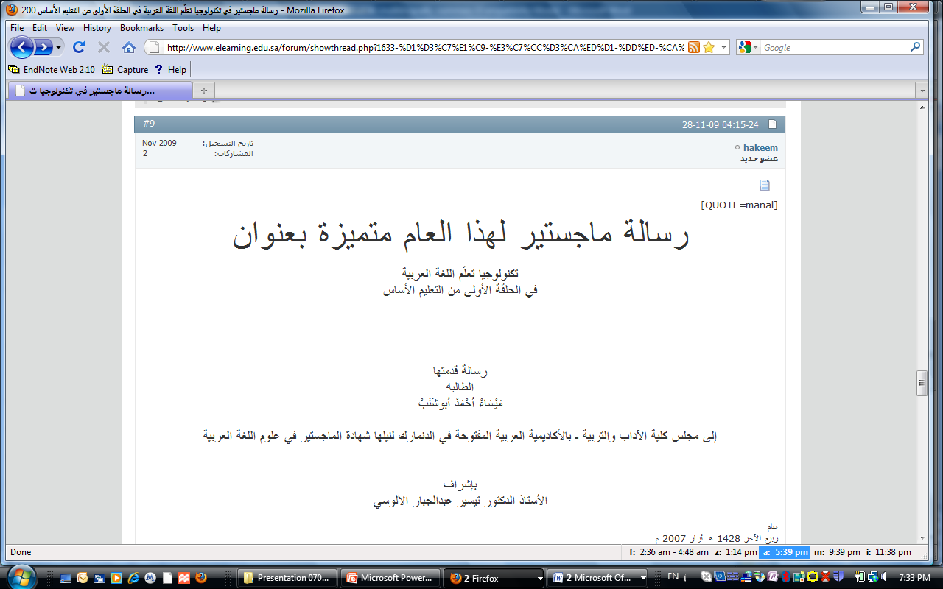
2. Research Training
Methodological foundation – English
Consulted literature in both English and Arabic

Slide 9
3. Data Collection
A Shift from English to Arabic (insider researcher)
A lot of translation initially, as the research was introduced to the participants
More access to Arabic references – Visiting libraries in Cairo

Slide 10
3. Data Collection
Supervision Fieldwork
(English) (Arabic)

Slide 11
4. Data Analysis
Issues – independent decision making:
Translating audio/ transcribed data
Transcribing English words in Arabic interviews in English or in Arabic
Coding then translating/ translating then coding
Coding in English or Arabic

Slide 12
4. Data Analysis
Hi Diane and Hind,
Just thought I would briefly share some of my "software adventures": - Lime Grove IT desk provides Nvivo 7 to install on your home machine, but not Atlas or Endnote. They will soon provide Office 2007, if you are interested.
- I wrote to both Nvivo and Atlas. The former does not support Arabic at all, while the latter does to a limited extent. In other words, you can see the text in Arabic but not the codes. I am still in contact with Atlas to see how to turn those small questions marks into Arabic script. - I also wrote to another company "maxqda", who answered back today. They said they fully support Arabic, so we might want to explore their software. Hope this helps :-) Sincerely, Mariam (June 7, 2007)

Slide 13
4. Data Analysis - Maxqda

Slide 14
5. Writing-up
Predominantly English literature and English coding helped with the writing up
Challenges with the translation: idioms, style..
Communication with supervisors

Slide 15
The words “experiment”, “play”, or “fiddle” are not accurate translations of the Arabic term that the teacher frequently uses in her data. It’s an Egyptian colloquial word that refers to patiently spending time and exerting effort to play with something and try different things with the aim of reaching a specific objective. Depending on the task at hand, people might try buttons, look into books, ask others, find themselves back to square one, start all over again, and so on until they reach their objectives.. Is there one verb in English that saves all those lines?

Slide 16
So What?
Rich complexities of doing research multilingually
More researcher responsibility and autonomy
Implications for research training, researcher competence, supervision.. etc

Slide 17
Continued Reflection

Slide 18
Continued Reflection

Slide 19
Continued Reflection
Expanding to Durham (July 7-8, 2010)
BAAL 2011 (September 1-3, 2011)

Slide 20
Thank you
mariamattia@live.com

