Slide 1
Exploring computer mediated intercultural communication
Richard Fay and Diane Slaouti, School of Education

Slide 2
Communication as meaning attribution
Communication [is understood to be] … that which happens whenever someone responds to the behavior or the residue of behaviour of another person.
When someone perceives our behaviour or its residue, and attributes meaning to it, communication has taken place regardless of whether our behaviour was conscious or unconscious, intentional or unintentional. ….
Being necessitates behavior. If behaviour has communicative potential, then it is impossible for us not to communicate. In other words, we cannot not communicate. (Porter and Samovar, 1994, in Samovar and Porter, 1994: 8)
Notes:
Our starting points: 1 - we are interested in communication as a process of meaning attribution

Slide 3
Computer mediated communication
‘Recently, I got an email complaining about an article I'd written. It happens. The angry tone was nothing if not consistent until very near the end. One question. After all that rage, why did she sign off with her first name and two kisses?
This week I received an email from a PR woman with whom I had not previously corresponded, let alone met. It started with "Hi Stu" and ended with "warm regards". The "warm" part especially threw me. What is going on in my inbox?’ (Jeffries, 2007,
http://www.guardian.co.uk/technology/2007/jun/26/g2.onlinesupplement
Notes:
2 – meaning attribution as realised in CMC contexts. This is a piece we refer students to early on to begin to encourage them to reflect on communication behaviours

Slide 4
Computer-Mediated Intercultural Communication (CMIC)
Exploration of CMC, IC, CMIC via reading and discussion
CMIC Project
with e-partners in Uruguay and Indonesia
culture
To develop an understanding of the characteristics, complexities and affordances of computer-mediated intercultural communication (CMIC)
communication
computer
Analysis of, and reflection on, the CMIC experience

Slide 5
Course structure
Course input sessions
Computer Mediated Communication
Intercultural Communication;
Computer Mediated Intercultural Communication
Data analysis
CMIC project exchange
Phase 2
CMIC Project exchange
Phase 1
Establishing Contact; personal introductions; negotiating tools and goals
Phase 3
Data analysis; reflections
Phase 4
Demonstration of learning
Summary of project outcomes in the project wiki (text or other multimedia formats);
A negotiated reflection on the exchange process
An written account of learning about CMIC

Slide 6
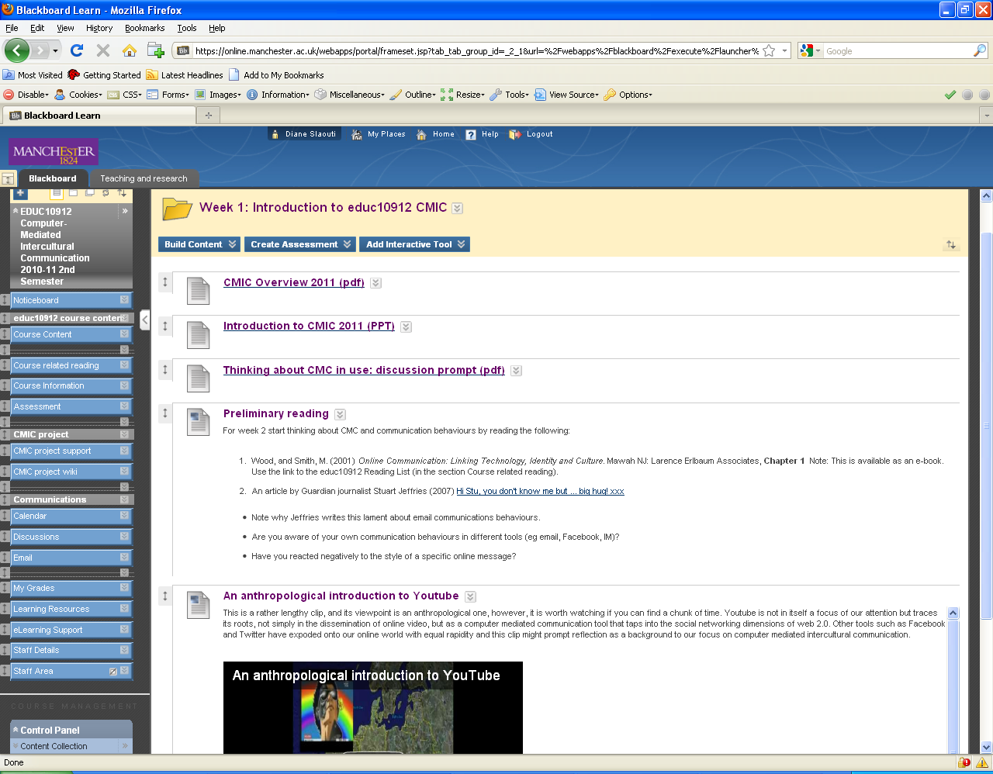
Tools (1) Manchester students’ home base
Notes:
Rationale for decisions about tools

Slide 7
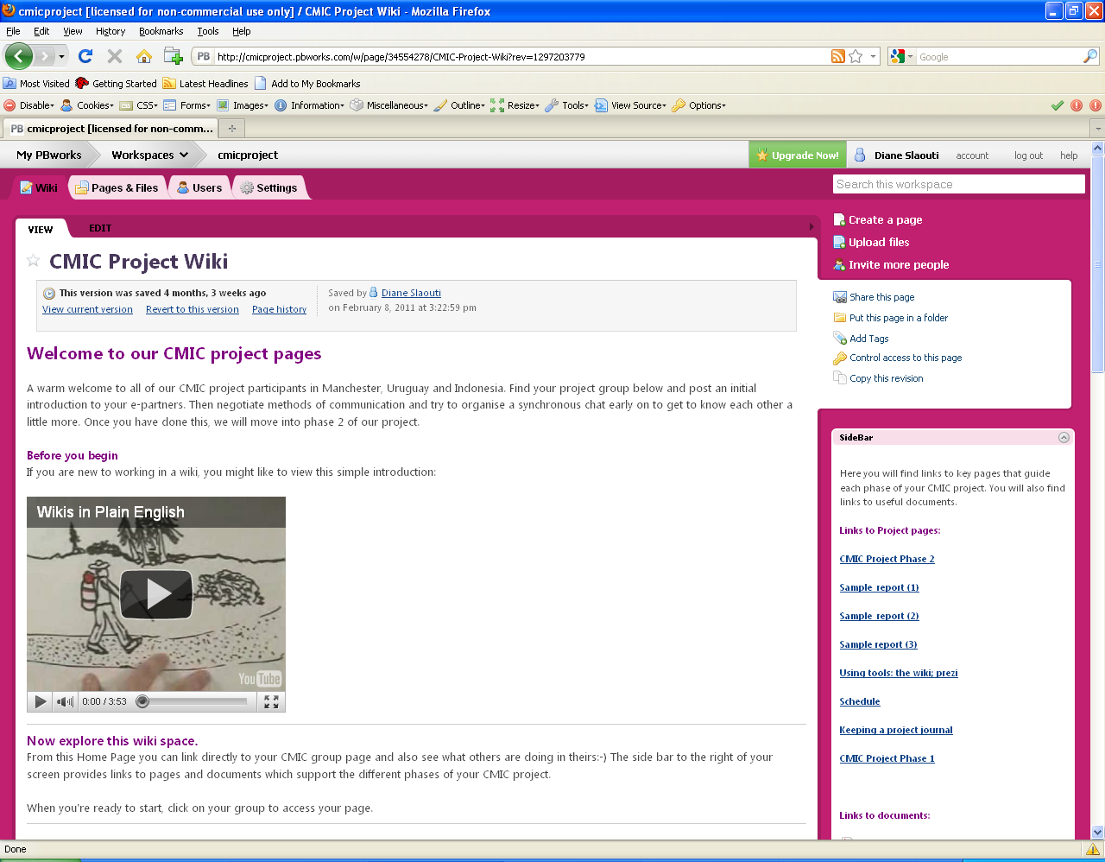
Tools (2) CMIC project base

Slide 8
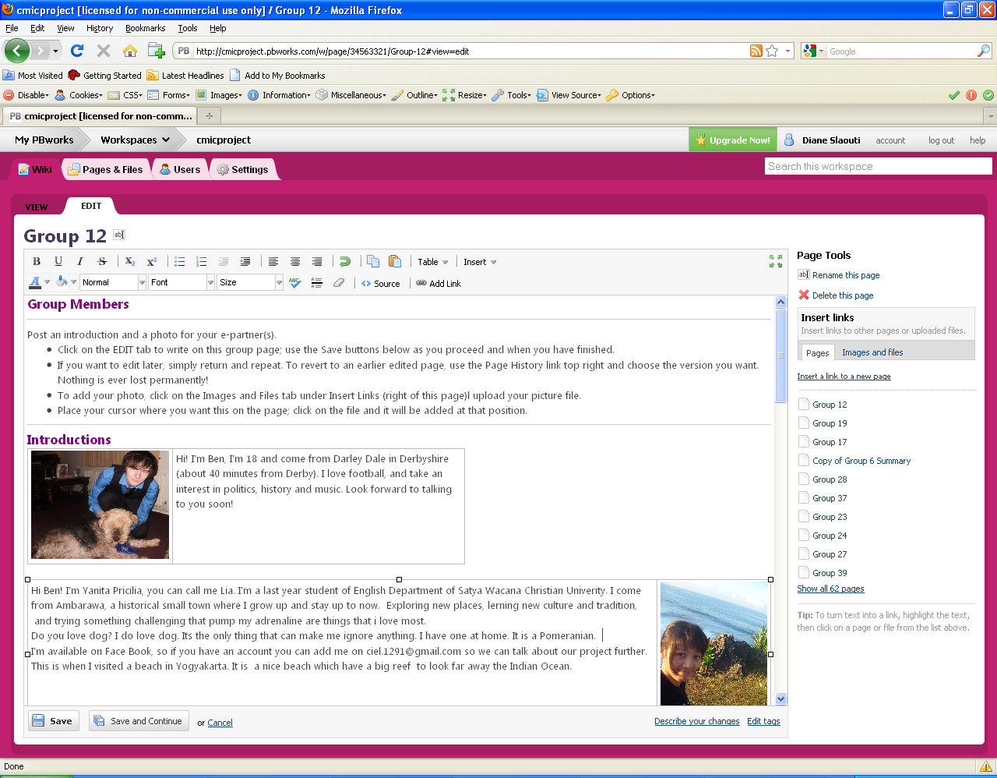
Wiki group spaces

Slide 9
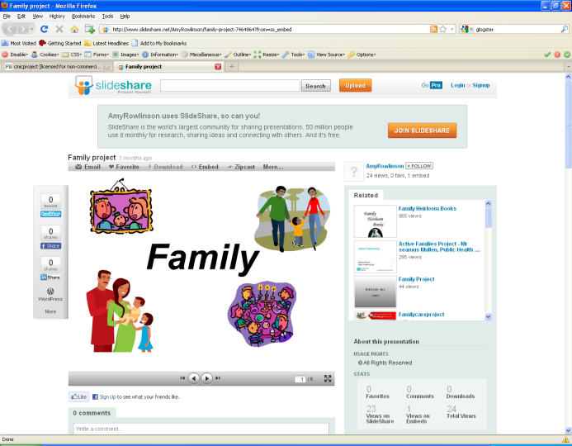
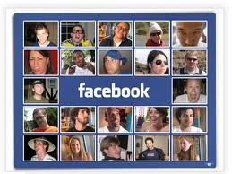

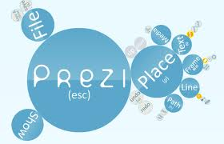

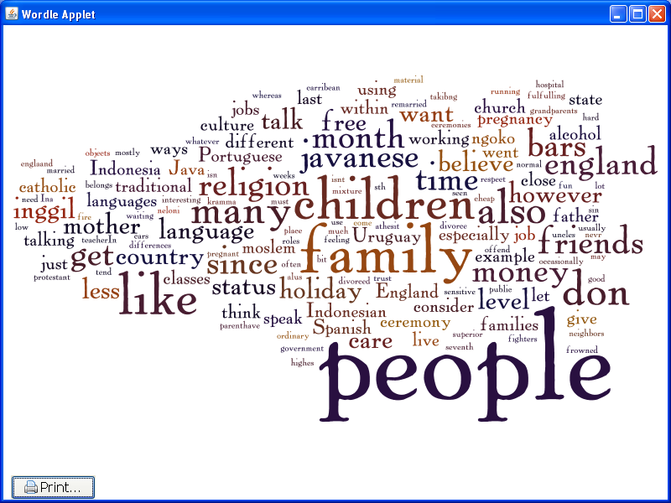
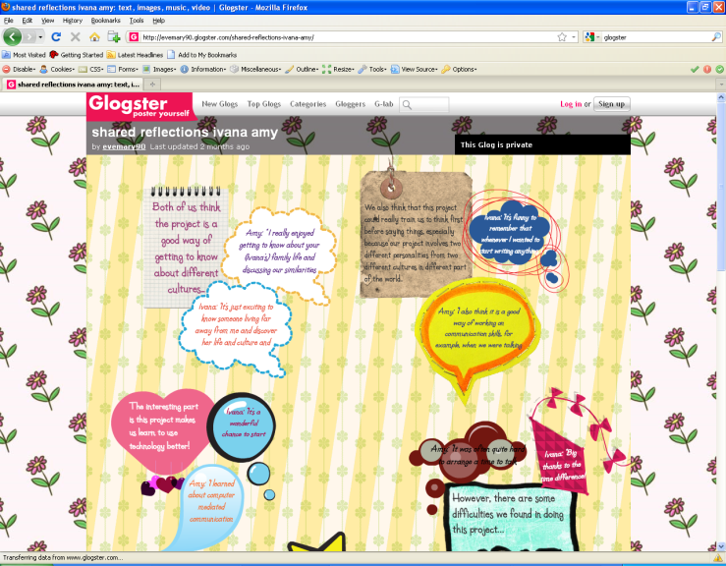
Tools (3) CMIC partners’ toolkit

Slide 10
Learning: communication skills
O’Sullivan outlines three ways of perceiving the communication of others: the ‘Alpha mode’ where we make assumptions based on our own culture, the ‘Beta mode’ where we externalise and are able to see alternative norms and perceptions and finally the ‘X mode’ (O’Sullivan 1994 p99) where communicators see that their norms are inappropriate but cannot think of any viable alternative . During my communications I tried to be in ‘Beta mode’ constantly, always looking for other possible interpretations if I could not seem to attribute the correct meaning to my partners’ communications.
Notes:
Emphasise selection of representative insights form assignments ie phase 4. Brief reference to O’Sullivan as a set of tools to encourage reflection on communication skills
Brief reference to O’Sullivan as a set of tools to encourage reflection on communication skills
Brief reference to O’Sullivan as a set of tools to encourage reflection on communication skills

Slide 11
Learning: language awareness
During our synchronous chats both M and myself often used exclamation marks for emphasis, whether it was to stress something important or even something funny. I also found that I used a lot of emoticons, such as the ‘☺’ smiley face, as I always wanted to appear friendly and polite. I seemed to use these a lot more than M did. I comment in my journal after our first synchronous chat: ‘M sometimes comes across as a bit direct but that could be because of the language barrier’. On reflection, this could also be due to her lesser amount of emoticons, giving me little insight into her feelings. It also could be a cultural difference in the ways we use emoticons, for example, M might have thought that I had been ‘over-using’ them.

Slide 12
Learning: language and tools
A cultural difference that I observed was my partners’ occasional tendency to be more direct than I was used to. For example in asynchronous chat 2.1.7 (highlighted in red) when Camilla has trouble understanding Benny, she simply says ‘Benny, I think I do not really understand you, what I think is that we should…’ This appeared very direct to me at the time and it was not resolved immediately because of the asynchronous nature of the communication. However, the next day apologies were exchanged and the miscommunication was explained (also highlighted in 2.1.7.)

Slide 13
Learning: tools and communicative purpose
After our second synchronous chat, I felt a lot better about our project. Up until this, we had been mainly interacting via email on Facebook, and the time between replies caused me to feel rather uneasy. A lot of our Facebook emails start with ‘Sorry for the late reply’. The gap between emails was very frustrating at times as I was starting to worry about our lack of progress. Although synchronous chats contain a lot more miscommunication, we were able to negotiate our way through and repair immediately. My experience taught me they are a lot more productive, we got through a lot of work and we also got on well whilst we were doing it.

Slide 14
Learning: others as they see you online
I first noticed myself consciously thinking of the difference between myself and Monica’s culture when deciding which picture to use to represent myself in the wiki. I was unsure as to Indonesian views on for example clothing choices or excessive drinking. I noted in my journal, ‘as I don’t have a camera, the only recent pictures of me have all been taken by friends on nights out’. During our early lectures, I was struck by a quote from Porter and Samovar (1994): ‘when someone perceives our behaviour or its residue, and attributes meaning to it, communication has taken place regardless of whether our behaviour was conscious or unconscious, intentional or unintentional’. Not wanting Monica to form negative perceptions of me based on my picture alone I chose quite an old photo, where I was just smiling, even though it looked quite different to how I now look.

Slide 15
References
O'Sullivan, K. (1994) O'Sullivan, K. (2001) Understanding Ways: Communicating between cultures. Sydney: NSW, Hale and Iremonger.
Samovar, L. and Porter, R. (eds.) (1997). Intercultural communication: A reader (8th edn.). Belmont, CA., Wadsworth

