Slide 1
Among the IALIC-ists: the transcreation of intercultural knowledge landscapes
Richard Fay, Vivien Xiaowei Zhou and Zhuo Min Huang
24th November 2016

Slide 2
Structure
Background to the study
Methodological and Conceptual aspects (work in progress)
Some outcomes/insights so far
Initial attempts to map shaping influences ...

Slide 3
Evolving/Emergent Cultures of IALIC (1)
Some starting points (1) …... the field of IC (and IALIC in particular)
is relatively young, and dynamic, and has interesting ‘fault-lines’: e.g. meeting points between: cross-cultural (essentialist-leaning) approaches and more critical perspectives; education- vs business- vs language-oriented foci; Global North and Global South theorising; etc
represents a rich site/space of/for ‘knowledge-work’, i.e. intercultural communication viewed as an emergent ‘knowledge landscape’ (Clandinin & Connelly)
Exploration of such knowledge-work and this emergent landscape might reveal something about:
the field of IC itself (what our understandings at this juncture? Where have come from? Where might they be headed? etc)
the processes (e.g. transcreation) through which this landscape is evolving
the possible shaping influences on the emergent ‘culture of IALIC’

Slide 4
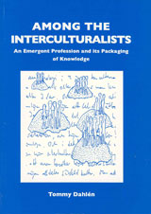
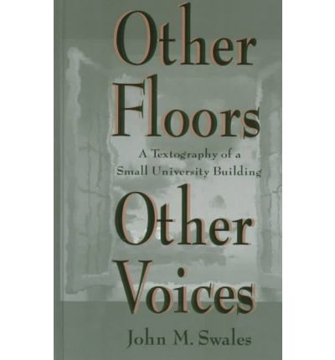
Evolving/Emergent Cultures of IALIC (2)
Some starting points (2) …... possible lines of exploration:
Our title intentionally echoes Tommy Dahlén’s (1997) ethnography of the developing field of intercultural communication.
His focus = the emergent professional cultures (of IC) (e.g. SIETAR)
Our focus = on the emergent (researcher-practitioner) cultures of an association (i.e. IALIC).
Whereas Dahlén worked ethnographically, we are intrigued by John Swales’ (1998) study of texts (i.e. a textography) within a university building to understand what happens in it and what it means to those involved
We are focusing on IALIC texts to better understand what is happening in our association and what this means for us.
Also: Dwight Atkinson’s (1999) study of corpus of 1984-1998 ‘culture’ articles in TESOL Quarterly.

Slide 5
Initial Exploration: Piloting Moves
Focus
“What can we learn about the emerging cultures of IALIC (as a key intercultural association) from a study of the texts that its members write for its conferences?”
Develop a text corpus based on:
Calls for Papers for recent (globally-distributed) IALIC conferences (e.g. Durham 2012, Beijing 2015)
Sets of recent IALIC conference titles, abstracts, and keywords
Focus on terms/ideas used and authors cited
Trial analytical possibilities including:
content analysis, word-clouds/wordles/word-trees, corpus/concordancing techniques, network analysis ….
Work in progress (initial stages)

Slide 6
Initial Exploration: Conceptual Underpinning
IALIC annual conferences, staged ‘alternately’ in Europe and Asia, represent a site for the transcreation of an ‘intercultural communication’ knowledge-landscape.
Building on previous work (Huang, Fay and White, 2015; forthcoming, 2017), the term transcreation refers to the transformative possibilities and complexities (i.e. across time, space, languages and cultures, disciplines and domains, etc.) of knowledge-work in our increasingly interconnected world.
It is partly through such transcreational processes that knowledge-landscapes (Clandinin and Connelly, 1995) evolve and develop.
The transcreational processes are shaped by influences such as the location of the conference (i.e. geographical), its the hosts (i.e. institutional, departmental, disciplinary), and Calls for Papers (i.e. thematic), etc.
The emerging cultures of IALIC can be explored diachronically and synchronically.

Slide 7
Examples: high-frequency words in ‘Calls for Papers’
Durham (2012)
Word | Count
intercultural | 25
communication | 20
education | 9
language | 9
cultural | 5
dialogue | 5
asian | 4
linguistics | 4
research | 4
competence | 3
international | 3
practices | 3
theories | 3
applied | 2
approaches | 2
challenges | 2
china | 2
conflict | 2
current | 2
dimensions | 2
disciplines | 2
Beijing (2015)
Word | Count
intercultural | 21
communication | 14
language | 13
practices | 8
communities | 7
local | 7
conflict | 6
education | 6
international | 6
social | 6
development | 5
new | 5
research | 5
cultures | 4
researchers | 4
change | 3
chinese | 3
foreign | 3
identity | 3
management | 3
multilingual | 3

Slide 8
Examples: Key-themes in ‘Calls for Papers’
Durham (2012)
intercultural communication into the 21st century
internationalisation and languages/intercultural communication/education
the cultural/intercultural dimensions of language learning and teaching (pedagogies)
emerging theories and methodologies for intercultural communication and language research
researching multilingually
intercultural (communication) competence and its assessment
interfaith/intercultural dialogue
ethical communication; intercultural responsibility
global/local citizenship and the intercultural
conflict, mediation, negotiation and peace communication
plurilingualism; bilingual and multilingual communication and education
political/historical/religious/geographical influences on intercultural communication
linguistics; sociolinguistics; applied linguistics
new technology and intercultural communication
Beijing (2015)
Intercultural communication practices in language education
e.g. Multilingual, multicultural practices and language teachers; Development of intercultural competence; New technology and intercultural education
Intercultural conflict and conflict management in communities
e.g.Intercultural conflict and emotional management; Power, politics and conflict negotiation
Preservation and exploration of indigenous/local/native cultures
e.g. Ethnocentric bias in intercultural (competency) models; Diversity and heterogeneity in indigenous/local/native cultures; Change, fusion and recreation of local cultures; Intercultural competency models revisited in local cultural contexts
Migration and international relocation
e.g. Academic socialization of international students;Language and identity development
Other institutional practices
e.g. Intercultural communication in the workplace;Translation and intercultural communication; Language, identity and international crime

Slide 9
Examples: Keywords in abstracts
Beijing (2015) -- keywords tagged by authors for their abstracts
Word | Count
intercultural | 58
communication | 29
cultural | 28
culture | 22
competence | 19
education | 15
language | 15
English | 14
Chinese | 13
analysis | 12
discourse | 11
china | 9
teaching | 9
awareness | 8
identity | 7
translation | 7
communicative | 6
critical | 6
cross | 6

Slide 10
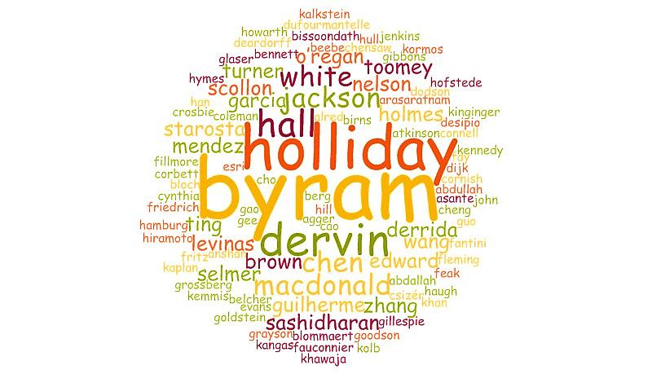
Examples: Wordcloud of cited-authors
Beijing (2015)

Slide 11
Aims:
to promote critical engagement with the notion of mediating between cultures and languages;
to explore the role of technology in bridging between diverse languages and cultures;
to explore the role of ‘broker’ in cross-cultural situations, including growing instances of ‘child language brokers’;
to promote understanding of how language brokering is perceived by researchers and practitioners from cross-cultural situations;
to provide a forum for a critique of existing analytical models of culture and language mediating practices that integrate current theories of language and intercultural communication;
to provide a forum on ways in which research into language and culture mediation can inform teachers’ praxis.
Themes:
‘Bridging’ of languages and cultures in the workplace
‘Translanguaging’ practices
New approaches to analysing language and cultural mediation
Research models for language and culture brokering
Language and culture brokering and technology

Slide 12
Exploring shaping influences on IALIC ‘cultures’
1991
2016
Diachronic
Themes
IC fields
Synchronic
IALIC
Cultures
Time
Location
Durham
Beijing
Barcelona
Possible shaping influences: points in time, geographic locations, host departments and disciplines, thematic foci, ….

Slide 13
Some Concluding Thoughts
Our initial explorations (a kind of textography) of IALIC conference-related texts (e.g. Calls for Papers, Paper/Plenary Titles, Abstracts, Keywords, Special Issues of L&IC) suggests that evolving (over time) and emergent (at moments in time) ‘cultures of IALIC’ can be mapped.
Such mapping might enable us to consider what influences shape these cultures (e.g. location, hosting institution/department, current disciplinary debates, timing, thematic focus of CfP).
The underpinning conceptual apparatus (of knowledge-landscapes and transcreational processes) seems helpful but needs more work.
Mapping each conference (synchronic textography) might reveal some of the dynamics at play as foregrounded by the location, the theme etc
Mapping the ongoing cultures of IALIC (diachronic textography) might reveal something about the enduring plausibility and explanatory power of some ways of understanding (e.g. national/regional discourses) as well as track the development of alternative ways e.g. anti-essentialist, critical approaches).
Such mapping might enable IALIC to better understand its role in our IC field and how perhaps to steer future developments in it (e.g. upcoming CfP etc).

Slide 14
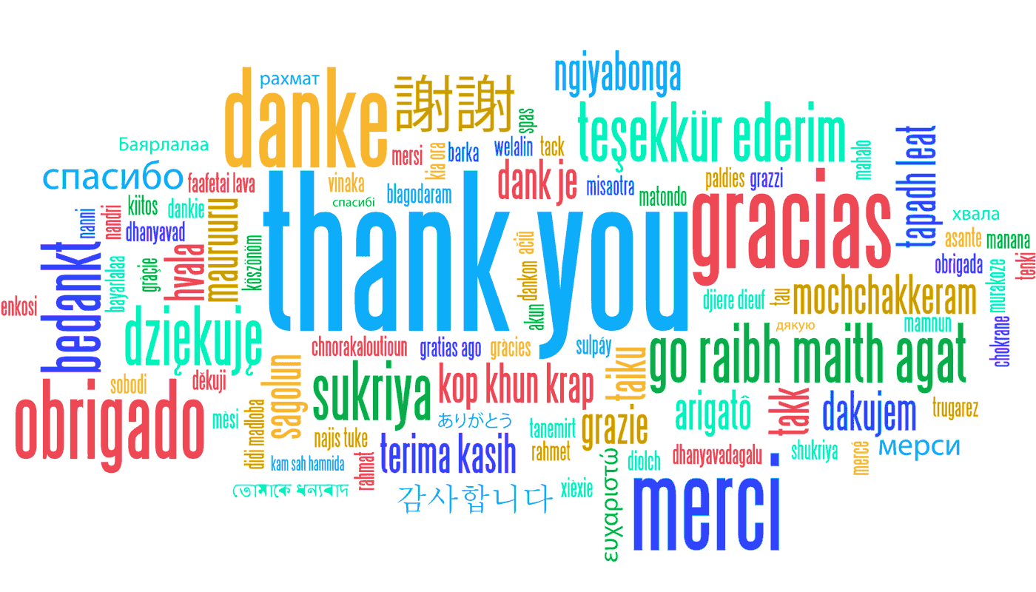

Slide 15
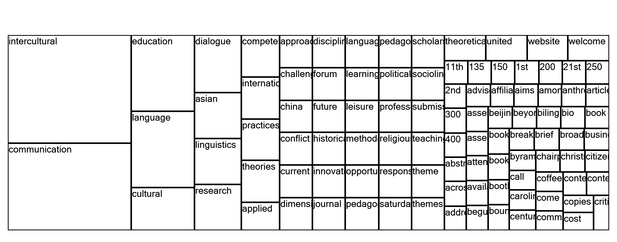
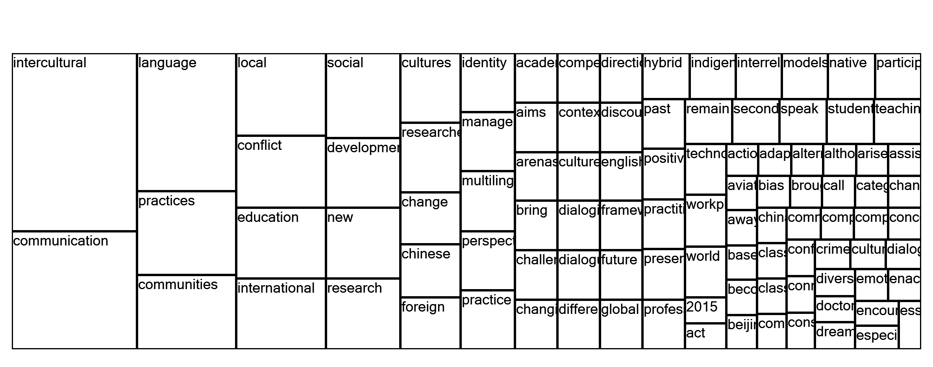
Examples: Word-trees of ‘Calls for Papers’
Durham (2012) Beijing (2015)

