Slide 1
Ecologies of Emerging English Language Curricula: Learning from Three Different Contexts
Sutraphorn Tantiniranat (Khwan)
Elisa Pérez Gracia (Elisa)
Siti Masrifatul Fitriyah (Fitri)

Slide 2
Outline
Part I Introduction
Part II English language situations in our contexts
Part III The development of the framework
Part IV Putting the framework to use and sharing insights
Part V Synthesising the shared agenda and some implications
Q & A

Slide 3
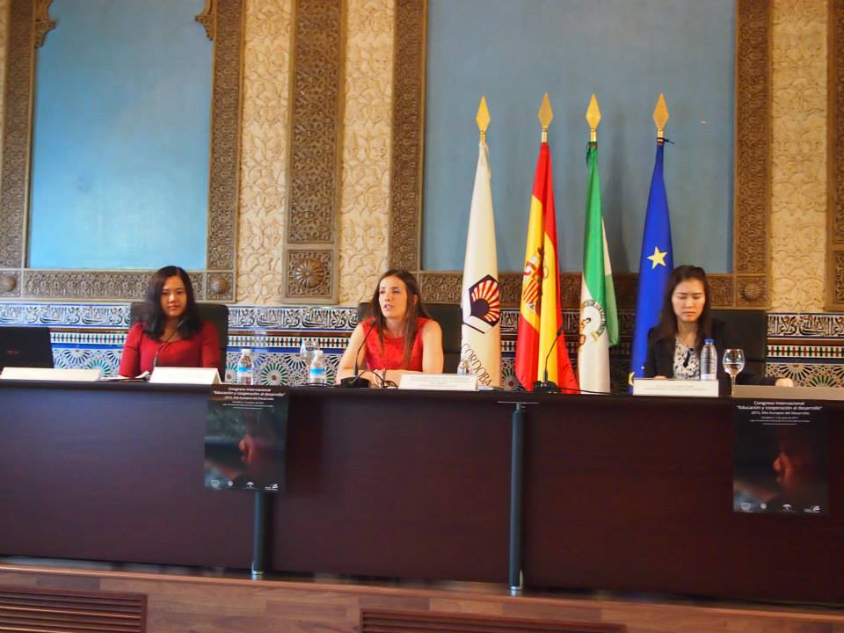
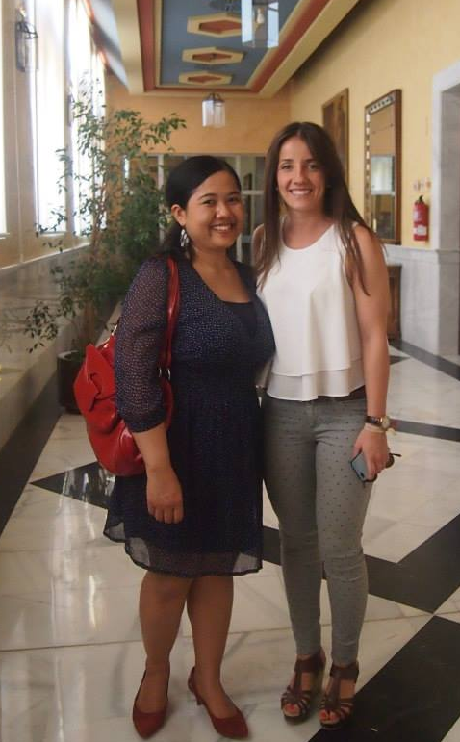
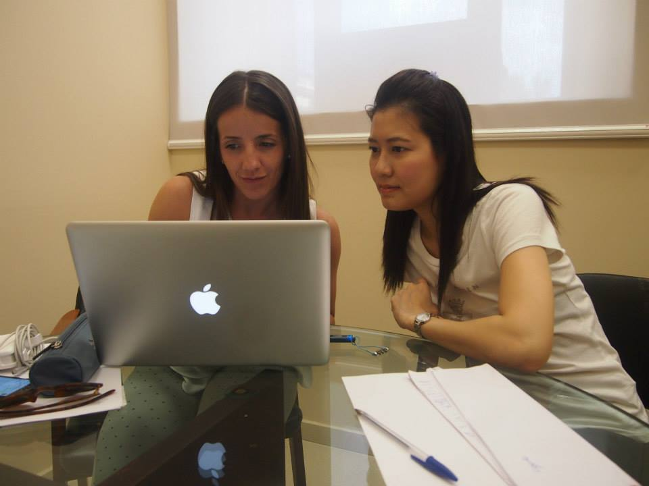
Part I

Slide 4
The purposes
Part I
The purposes of this work:
To understand the ecologies of emerging English language curricula (henceforth, “the ecologies”)
To identify implications for the practice of Teaching English to Speakers of Other Languages (TESOL)
To enrich our specialist’s experiences through an appreciation of the ecologies of the other contexts
To contribute to a better understanding of the complexities of the TESOL world
The purpose of this presentation:
To share what we have learned so far concerning the ecologies
To introduce you to our mapping device we developed and how to put it in use
To demonstrate how it might be applied to suit other purposes

Slide 5
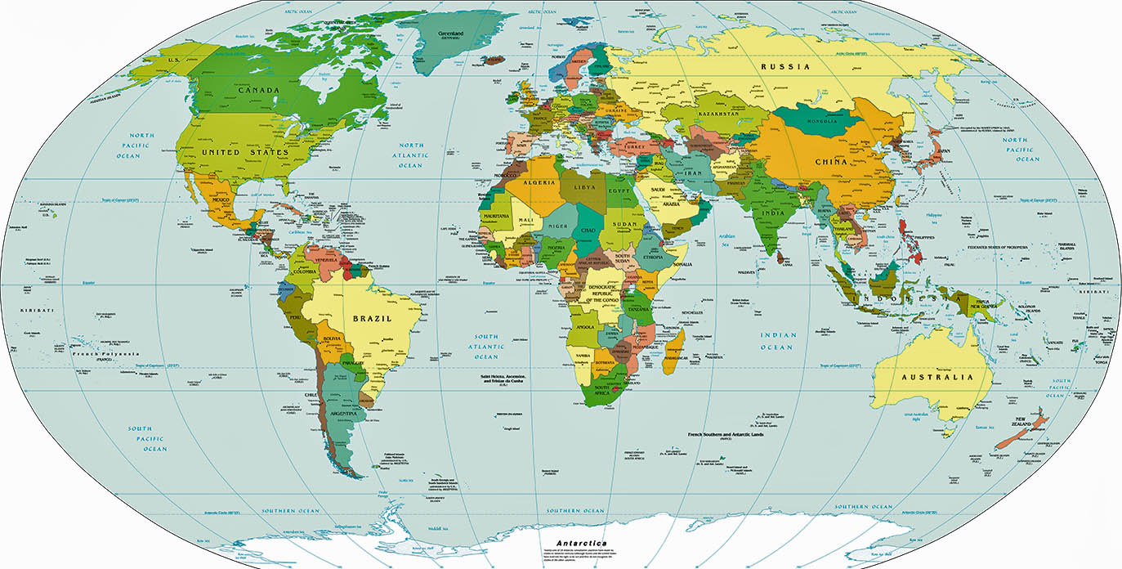
Part II

Slide 6
English language situations in our contexts: similarities and differences
Part II
English as a Foreign Language; Expanding circle countries (Kachru, e.g. 1992, 1996)
English as working language of ASEAN and EU (+23 more)
Importance of English in education, business, employment and tourism; the language of the elites in Indonesia
English as a compulsory subject (basic education, higher education in Thailand; secondary and higher education in Indonesia; A foreign language compulsory in Spain)
Societies becoming more multicultural and multilingual in terms of language education; English as the dominant foreign language taught; the promotion of the teaching and learning of other foreign languages in EU and ASEAN

Slide 7
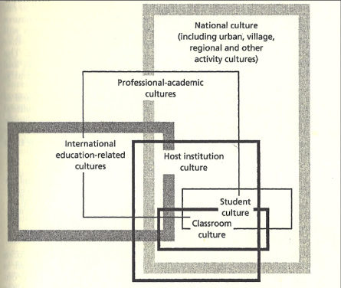
The development of the framework
Part III
3.1 The ecologies thinking and Appropriate Methodology
“best practice” , “best methodology” in TESOL
Adrian Holliday (1994) Appropriate Methodology
Host Culture Complex (HCC, ibid, p. 29 )
Ecological thinking

Slide 8
Part III
1. Global
2. Supranational
3. National
5. Teachers’
perspectives
4. Sub-national
(region)
6. Examination
culture
English language
curricula
Mapping the ecologies of the emerging English language curricula (Adapted from Holliday, 1994, p.29)

Slide 9
Putting the framework to use and sharing insights
Part IV
1. Global
2. Supranational
3. National
5. Teachers’
perspectives
4. Sub-national
(region)
6. Examination
culture
English language
curricula
Mapping the ecologies of the emerging English language curricula (Adapted from Holliday, 1994, p.29)

Slide 10
Synthesising the shared agenda
Part V
The complexities of language situations around the globe
The mismatch views of English and how it is taught
The major shaping influences eminent in our contexts
Implications for TESOL
Policy makers could (and should)…
Consider all the macro and micro factors in curricula planning and implementation
Involve teachers more extensively in the curriculum planning and implementation
Consider the reorientation of English language teaching away from the native-speaker norms of an EFL orientation, embracing instead the teaching of communication skills for this intercultural age
Question whether teaching English as the only (foreign) language is sufficient for the purposes of international and intercultural communication
Consider the need to develop young people’s skills and mind-set to be able to communicate and live with others in ‘plurilingual’, ‘multicultural’ societies

Slide 11
Thank you
Muchas gracias
Terimakasih banyak

Slide 12
References
Holliday, A. 1994. Appropriate methodology and social context, Cambridge, Cambridge University Press.
Kachru, B. B. (1992). World Englishes: Approaches, issues and resources. Language teaching, 25(01), 1-14.
Kachru, B. B. (1996). World Englishes: agony and ecstasy. Journal of Aesthetic Education, 30, 135-155.

