Slide 1
Transformative Creativity: Arts and Performance in Language and Intercultural Research
Lou Harvey
University of Leeds
Richard Fay
University of Manchester
Jessica Bradley
University of Leeds
Zhuomin Huang
University of Manchester

Slide 2
Collaboration and co-creation in adapting language and intercultural research for performance
Lou Harvey
University of Leeds

Slide 3
Collaboration and co-creation
‘Trans-ing’ (Mylona 2016)

Slide 4
My research
Language learning motivation as ideological becoming (Harvey 2014; Bakhtin 1981)
Bakhtin and the polyphonic novel (1984): the author creates ‘freedom for others’ points of view to reveal themselves’ while maintaining a ‘positive and active quality’ (67)
Dialogic interview methodology: talking with rather than talking to the participants (Harvey 2014, 2015)

Slide 5
Why adapt for performance?
Findings: communicative struggles in UK despite high English proficiency – destabilising
Migration, ‘integration’, English:
awareness of immigrants’ (language) experience
collective responsibility for accommodation and hospitality
Ethics – what happens to research stories?
How to communicate research to the public?

Slide 6
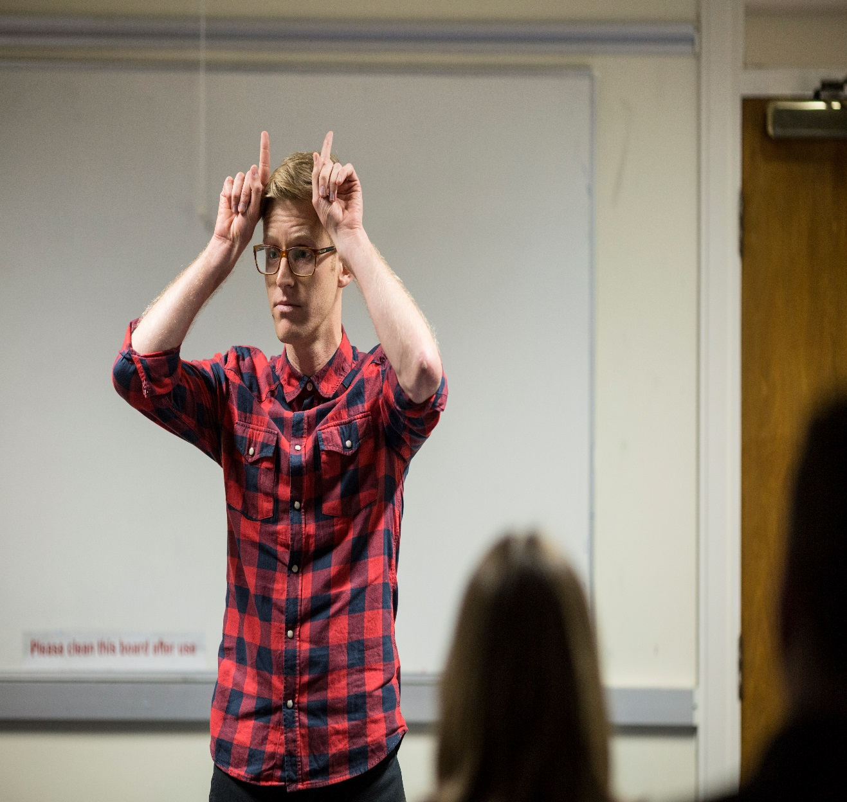

Leeds Creative Lab: Working with Cap-a-Pie

Slide 7
the assumption that you know what’s going on around you, but then you realise that actually you don’t know the rules
Brad: ‘Making the mechanics visible’

Slide 8
Creative inquiry
Stimulus: Short verbatim text from research
Brainstorming themes
Responding creatively to themes: idea for a restaurant and a business
Philosophical question based on two themes: ‘What ambitions are acceptable?’
Creating characters, stories, scenes, dialogues

Slide 9
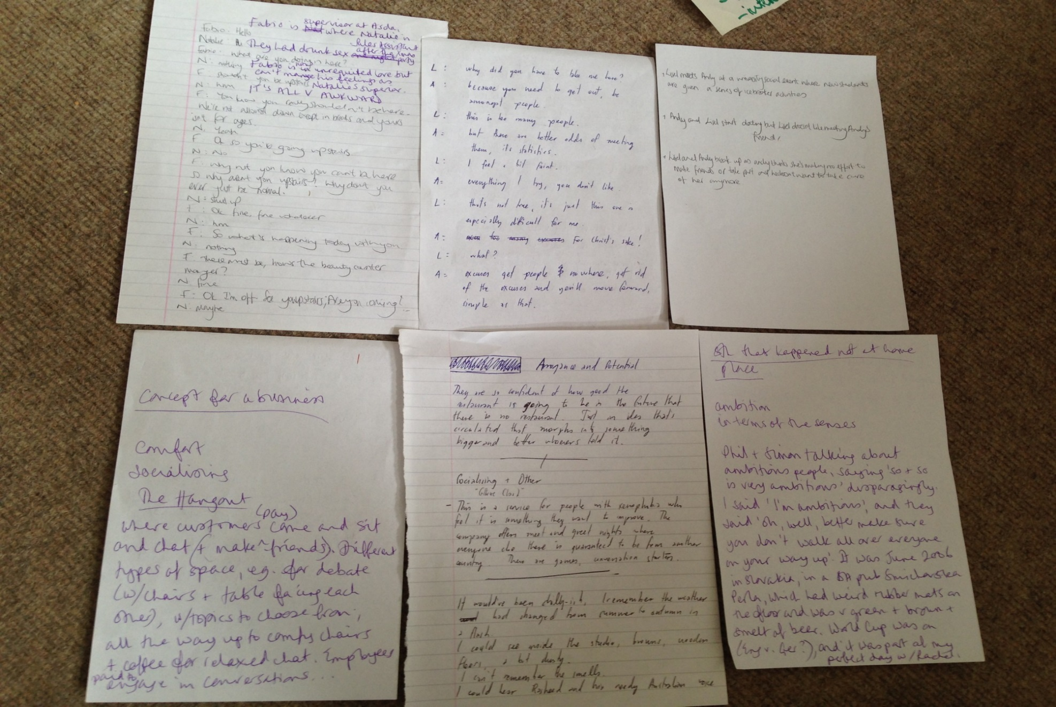
‘What ambitions are acceptable?’

Slide 10
Making the mechanics visible in Up and up and up towards…
Began with | Shifted to
Story narrated by actor, with actions to denote the characters | Actor stepping out of role to comment on the story or on his performance (e.g. changing some of the actions)
Story narrated in English | Some sections spoken in gibberish
Story follows a recognisable narrative development pattern | Story change without warning at climactic point: Icarus was flying up and up and up towards the pub that Andy and Liesl went to on a Friday... - Shift again as Liesl flies to London, up and up and up towards end of Icarus story
Audience sitting facing/watching the performer | Audience asked to recreate a pub and individuals asked to play Liesl

Slide 11
Audience responses
What the performance was about | Responses to it
Non-verbal communication Interweaving stories Languages Silences Interruptions Fantasy Not understanding Communications Filling in the gaps Storytelling Setting up & breaking convention Semiotics Making sense | Multifaceted Withdrawal Uncomfortable (x 2) Unpredictable Anticlimax Disruption Incongruous Immersive Engaging Humorous Delightful Constructive Neutral Absurd Celebratory of narrative Suspenseful Spontaneous

Slide 12
‘Trans-ing’ in Up and up and up towards
Performativity, ‘trans-’ (Jones 2016), ‘trans-ing’ (Mylona 2016)
Andersen (2016) on performativity and trans-: anti-essentialist, poysemous, processual, relational
When trans- is understood as process, it highlights ‘our relationship to knowledge creation as performative … the trans- is itself fluid and multipurpose, a mode of performing complex relationships between one site, identification or mode of speaking/doing/being and another’ (Jones 2016: 4, 2)

Slide 13
‘Trans-ing’ in Up and up and up towards
Performance created on multiple planes, through a process of ‘interthinking’ (Littleton and Mercer 2013)
Knowledge transcreation (Huang and Fay 2016): ‘a multi-directional and inter-transformative process of merging, encompassing and (re)creation ... an inter-transformative (e.g. trans-lingual, trans-cultural, trans-disciplinary, trans-practitionality, trans-methodological and trans-conceptual) space of thinking and interthinking’ (n.p.)

Slide 14
‘Trans-ing’ in Up and up and up towards
‘ensemble thinking … a mode of transauthorship’ through which ‘our voicing percolates’ (After Performance Working Group 2016: 35, 36).
We use the prefix ‘trans-’ not to attempt a transcendence of the figure of the author or of authorship, but to attest to an experience of transmutating beyond the boundaried authorial self, towards moments of transparency, transmission, and the transit – or more definitively the circulatory movements – of ideas’ (APWG 2016: 36).

Slide 15
‘Trans-ing’ in Up and up and up towards
Up and up and up towards allows for ‘an understanding of a field of knowledge in a momentary and processual way – it … enables rather than confirms or fixes knowledge about the world’ (Jones 2016: 5, citing Gotman 2016)
sensing rather than thinking (Mylona 2016)

Slide 16
Conclusion: A different form of knowledging?
Is Up and up and up towards is ‘a new object, that belongs to no-one’ (Barthes 1984: 72) …
… or ‘a new object’, that belongs to everyone?
Transcreation and transauthorship
‘an ethos of critical care’ (After Performance Working Group 2016: 35)

Slide 17
References
After Performance Working Group. (2016). After Performance. Performance Research 21 (5), 35-36.
Andersen, T. (2016). An Object that Belongs to No-One. Performance Research 21 (5), 12-16.
Bakhtin, M. M. (1981). The dialogic imagination: Four essays. (M. Holquist, Ed.; C. Emerson & M. Holquist, Trans.). Austin: University of Texas Press.
Bakhtin, M. M. (1984). Problems of Dostoevsky’s Poetics. (C. Emerson, Ed. & Trans.). Minneapolis: University of Minnesota Press.
Barthes, R. (1984). The Rustle of Language (R. Howard, trans.). Berkeley: University of California Press.
Gotman, K. (2016). Translatio. Performance Research 21 (5), 17-20.
Harvey, L. (2014). Language learning motivation as ideological becoming: Dialogues with six English-language learners (Unpublished doctoral dissertation). University of Manchester, UK.
Harvey, L. (2015). Beyond member-checking: a dialogic approach to the research interview. International Journal of Research and Method in Education, 38 (1), 23-38.
Huang, Z. & Fay, R. (2016). Knowledge Transcreation. Unpublished working article.
Jones, A. (2016). Introduction. Performance Research 21 (5), 1-11.
Littleton, K. & Mercer, N. (2013). Interthinking: Putting Talk to Work. Abingdon and New York: Routledge.
Mylona, S. (2016). Trans-ing. Performance Research 21 (5), 65-67.
Ricoeur, P. (2006). On translation. Abingdon and New York: Routledge.

Slide 18
Thank you! L.T.Harvey@leeds.ac.uk

