Slide 1
Intercultural knowledge-work and the transcultural development of ideas: 念(niàn)/mindfulness, intercultural communication, and psychotherapy
The 15th IALIC Conference
(Beijing, Nov., 2015)
Zhuomin Huang
Richard Fay
Ross White

Slide 2
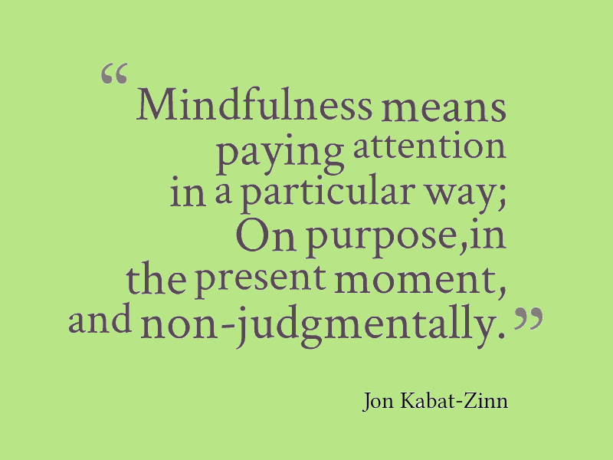
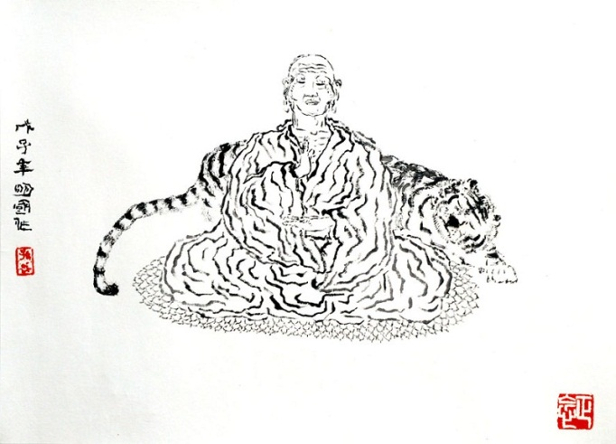
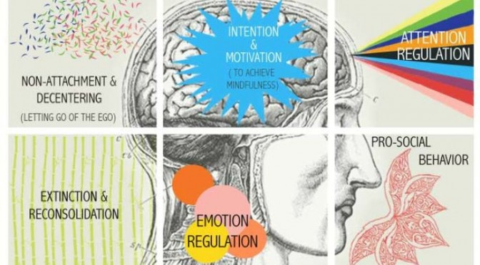
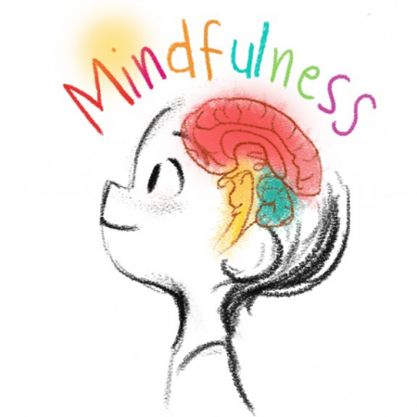
Mindfulness in the East and the West
Emptiness De-attachment Chan/Zen
The practice of ‘HEART’
niàn Stillness and Observation
Notes:
静中观心 （Heart-observation in Stillness） “观自在”是观世音菩萨的另外一个名号，意思是说，只要你能观照自己，你能认识自己，你就可以自在了。

Slide 3
Content
Mindfulness in the Orient
Mindfulness in Psychotherapy
Mindfulness in Intercultural Communication
Discussion:
mindfulness as a case through which to explore an intercultural perspective on ‘knowledge-work’ and ‘transcultural development of ideas’

Slide 4
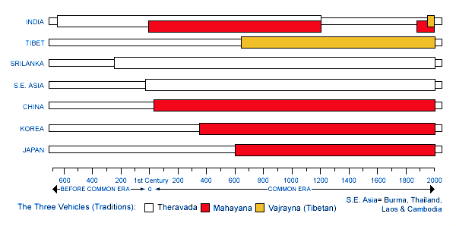
Mindfulness in the Orient
Religion
Morality
Psychology
Cognition
The Origin of Mindfulness:
Indian Buddhism (2600 years ago)
‘Sati’: ‘memory’ - the constant presence of mind, meaning ‘remember to be aware of’
4 Dimensions of Teachings
Spreading (1st Century):
S.E. Asia: e.g. Thailand: สติ (sa^{L} dti^{L})
China: 念 (niàn)
Vietnam (niệm)
Korea: 念/염 (nyem)
Japan: 念 (nen)
Notes:
Religious dimension
Buddhism Enlightenment
Overcome ‘suffering’
Moral dimension
See beyond ones’ own suffering
Ease the suffering of others
Psychological dimension
‘True balance’
Tame the ‘wild calf’ of the uncontrolled mind
Cognitive dimension
Understanding of ‘self’, phenomena and the world
Continuous cognitive transformation It reached China around the 1st century A.D., where Mahayana Buddhism later became the predominant school of thought, as many of its principles were compatible with the philosophies of Chinese scholars Lao Tse and Confucius. Several hundred years later, Buddhism spread to Korea and Japan, and towards Tibet.
http://www.buddhisttemple.ca/buddhism/timeline

Slide 5
Mindfulness in China (Traditional)
(niàn)
1. The Chinese Character:
memory by reciting and by heart
2. Merged with Chinese Traditional Philosophies (诸子百家) :
Cognition/Psychology
‘True Balance (禅定)’ in Mindfulness
Yin Yang ‘Balance’ (阴阳消长)
Daoism ‘Body + Energy + Spirit’ (形气神)
D./Confucius ‘Man-Nature-Unity’ (天人合一)
Morality
‘Compassion’ (慈悲观) in Mindfulness
Confucius ‘The Study of Ren’ (仁学; i.e. Benevolence)
释
The Hundred Schools of Thoughts
Buddhism
Daoism
Confucius
儒
道
Notes:
金文（今，“吟”）（心，表示惦记），表示口吟心忆。造字本义：心中有所忆，口中有所吟。
阴阳消长：一个整体（事物，思想，精神）中阴阳两部分的消长关系（相互制约转化）。
易经，变化，阴阳消长，变化是时时现象，不变是恒常规律 两种观念共同塑造中华民族伦理道德佛教的慈悲观和孔子的仁学观，都是关于人类伦理道德建设的根本性观念，是关于人性修养上的基本目标和要求。
大慈与一切众生乐，大悲拔一切众生苦。大慈以喜乐因缘与众生，大悲以利苦因缘与众生。”“慈”是慈爱众生，给予快乐，“悲”是悲悯众生，拔除痛苦，二者合称为慈悲。简言之，慈悲就是“与乐拔苦”
孔子的仁学观是孔子思想体系的核心价值。孔子将“仁”的观念系统化，铸造起以“仁”为核心的哲学范畴——即“仁学观”，成为儒学和中华民族伦理道德的根本观念导向。 “仁”，即“爱人”，这是一种博大的同情心和爱心，它既是一种生命的相互感通，是人、我、群、己之间的普通联系与相互关照，又是一种主体内在的意识自觉，是可以自己决定的道德自律和价值追求。儒家通过推广这种具有崇高道德价值的“仁爱之心”，提升人的精神，使之超脱寻常的人与我、物与我之别，从而达到“天人合一”的理想境界。
大乘佛教认为，没有广大众生的解脱，就没有个人真正的解脱。只有求得所有众生得到解脱，才能使自身得到彻底的解脱。这是大乘佛教慈悲救苦的菩萨行的最高要求。佛教的这种慈爱众生、同情众生、帮助众生、解救众生苦难的观念，对中国古代中华民族伦理道德的形成，产生了巨大的影响。
要求修行者要认识到世界万事万物都是因缘和合而生，一切现象都是各种条件和合形成的假相，是没有自性的，在本质上是空的
https://books.google.co.uk/books?id=N5aPlu9kKmoC&pg=PA30&lpg=PA30&dq=%E6%AD%A3%E5%BF%B5+%E8%80%81%E5%AD%90&source=bl&ots=HDQaBxR4OO&sig=RrN7VytGlGAvykjbillzd_QSdQE&hl=en&sa=X&ved=0CFsQ6AEwCWoVChMIqsO5y7iQyQIVxVkaCh1cwQRJ#v=onepage&q=%E6%AD%A3%E5%BF%B5%20%E8%80%81%E5%AD%90&f=false
http://www.zgfoxue.com/news/8438867.html
https://zh.wikipedia.org/wiki/%E4%B8%AD%E5%9B%BD%E5%93%B2%E5%AD%A6

Slide 6
Mindfulness in China (Modern)
Since 2009
Modern Flows from the West:
A psychological (meditation) tool for improving negative emotions (e.g. stress & depression)
A modern pursuit: Mindfulness for Success (成功学)
‘approved by the West’
‘a high status in the West’
‘influential in the West’,
‘popular in the West’
‘a Western psychotherapy’
“正念疗法，已被西方医疗界所肯定多年，。。。现已成为西方身心医疗的方法之一。 ”— 《正念》
“正念修行在西方世界拥有崇高的地位和广泛的影响力，。。。它是西方国家最为普及、最爱关注、最有影响力的佛教修行体系。”— 《图解正念：成功者必有正念》
Notes:
金文（今，“吟”）（心，表示惦记），表示口吟心忆。造字本义：心中有所忆，口中有所吟。
阴阳消长：一个整体（事物，思想，精神）中阴阳两部分的消长关系（相互制约转化）。
易经，变化，阴阳消长，变化是时时现象，不变是恒常规律 两种观念共同塑造中华民族伦理道德佛教的慈悲观和孔子的仁学观，都是关于人类伦理道德建设的根本性观念，是关于人性修养上的基本目标和要求。
大慈与一切众生乐，大悲拔一切众生苦。大慈以喜乐因缘与众生，大悲以利苦因缘与众生。”“慈”是慈爱众生，给予快乐，“悲”是悲悯众生，拔除痛苦，二者合称为慈悲。简言之，慈悲就是“与乐拔苦”
孔子的仁学观是孔子思想体系的核心价值。孔子将“仁”的观念系统化，铸造起以“仁”为核心的哲学范畴——即“仁学观”，成为儒学和中华民族伦理道德的根本观念导向。 “仁”，即“爱人”，这是一种博大的同情心和爱心，它既是一种生命的相互感通，是人、我、群、己之间的普通联系与相互关照，又是一种主体内在的意识自觉，是可以自己决定的道德自律和价值追求。儒家通过推广这种具有崇高道德价值的“仁爱之心”，提升人的精神，使之超脱寻常的人与我、物与我之别，从而达到“天人合一”的理想境界。
大乘佛教认为，没有广大众生的解脱，就没有个人真正的解脱。只有求得所有众生得到解脱，才能使自身得到彻底的解脱。这是大乘佛教慈悲救苦的菩萨行的最高要求。佛教的这种慈爱众生、同情众生、帮助众生、解救众生苦难的观念，对中国古代中华民族伦理道德的形成，产生了巨大的影响。
要求修行者要认识到世界万事万物都是因缘和合而生，一切现象都是各种条件和合形成的假相，是没有自性的，在本质上是空的
https://books.google.co.uk/books?id=N5aPlu9kKmoC&pg=PA30&lpg=PA30&dq=%E6%AD%A3%E5%BF%B5+%E8%80%81%E5%AD%90&source=bl&ots=HDQaBxR4OO&sig=RrN7VytGlGAvykjbillzd_QSdQE&hl=en&sa=X&ved=0CFsQ6AEwCWoVChMIqsO5y7iQyQIVxVkaCh1cwQRJ#v=onepage&q=%E6%AD%A3%E5%BF%B5%20%E8%80%81%E5%AD%90&f=false
http://www.zgfoxue.com/news/8438867.html
https://zh.wikipedia.org/wiki/%E4%B8%AD%E5%9B%BD%E5%93%B2%E5%AD%A6

Slide 7
Mindfulness in Western Psychotherapies
Definition: ‘a process of paying attention in a particular way: on purpose, in the present moment, and non-judgmentally’ (Kabat-Zinn, 1994).
Mindfulness-based therapies → effective treatments for psychological problems , especially for reducing anxiety, depression and stress (Khoury et al., 2013):
Example1: Mindfulness-based Stress Reduction (MBSR)(Jon Kabat-Zinn, 1979)
Example2: Mindfulness-based Cognitive Therapy (MBCT) (Segal, Williams & Teasdale, 2002)
Culture of Evidence-based Practice
Notes:
Mindfulness Based Therapies are an effective treatment for a variety of psychological problems, and are especially effective for reducing anxiety, depression, and stress (Khoury et al., 2013).

Slide 8
Criticisms about Mindfulness in Western Psychotherapies
Mindfulness has been lifted from its traditional root (Buddhism), transplanted in a secularized culture, and bent on pragmatic purposes (Bodhi, 2011, p. 35)
Mindfulness as an ‘antidepressant’ for getting rid of aversive experiences? Or for promoting a non-judgmental awareness of all experiences?
Western evidence-based medicine’s need to make the ‘mechanics’ of mindfulness knowable → mapping of mindfulness onto existing heuristics … is it effective medically ?
no place for religion [or philosophy?] in a secular, medicalised [evidence-based] western world

Slide 9
Acknowledging Sources/Credentials
Eastern perspectives
‘approved by the West’
‘a high status in the West’
‘influential in the West’,
‘popular in the West’
‘a Western psychotherapy’
Western Perspectives
‘… removed the Buddhist framework and eventually downplayed any connection between mindfulness and Buddhism, instead putting MBSR in a scientific context’
‘… mindfulness is not itself Buddhist at all but really a universal pathway to sanity and well-being…’
‘Historically, mindfulness has been called “the heart” of Buddhist meditation…’
Western favoured/privileged
Notes:
http://www.amazon.com/Mindful-America-Transformation-Buddhist-Meditation/dp/1491589671
Mindfulness has its origins in ancient meditation practices. The founder of modern day Mindfulnessis Jon Kabat-Zinn who founded the Stress Reduction Clinic at the University of Massachusetts Medical School in the late 1970's.

Slide 10
Mindfulness in IC
Intercultural Communication Competences:
Mindfulness means attending to one’s internal communication assumptions, cognitions, and emotions and, at the same time, becoming exquisitely attuned to the above of the other’s.
Psychology:
Mindfulness is a state of mind that results from drawing novel distinctions, examining information from new perspectives, and being sensitive to context. It is an open, creative, probabilistic state of mind in which the individual might be led to finding differences among things thought similar and similarities among things thought different.
(Thich, 1991, 1998; Ting-Toomey, 1999; Langer, 1993)
Notes:
Mindfulness, in the intercultural communication competence context, means
attending to one’s internal communication assumptions, cognitions, and emotions
and, at the same time, becoming exquisitely attuned to the other’s communication
assumptions, cognitions, and emotions (LeBaron, 2003; Thich, 1991, 1998; Ting-
Toomey, 1999). Mindful reflexivity requires us to tune into our own cultural and
personal habitual assumptions in scanning a problematic interaction scene. To be
mindful of intercultural conflict differences, we have to learn to see the unfamiliar
behavior from multiple cultural angles (Langer, 1989, 1997). In the context of the
intercultural conflict negotiation process, for example, we have to deal with our
own vulnerable emotions regarding identity and face-threatening behaviors.
Concurrently, we have to be responsive to new interaction scripts awaiting us.
We also need to develop multiple lenses in understanding the culture-level and
situational-level factors that shape the problematic conflict episode. Mindfulness is
part of the metacognition process that is a key feature in the cultural intelligence
research literature (Earley & Ang, 2003; Earley & Peterson, 2004). According to Ang
et al. (2007), metacognition refers to the “higher-order mental capability to think
about personal thought processes, anticipate cultural preferences of others and
adjust mental models during and after intercultural experiences” (p. 341). Mindfulness
of the mind is the mediating step in linking knowledge with the intentional
application of constructive conflict skill practice.

Slide 11
The Origins of Mindfulness in IC?
Gudykunst (1995): Mindfulness is the way that in-group members and strangers can reduce their anxiety and uncertainty to optimum levels.
Ting-Toomey (1998): Mindfulness (Thich, 1991) means … According to Langer (1989; 1997), to act mindfully, we should learn to…

Slide 12
Acknowledging Sources/Credentials
The origin of mindfulness is absent in most of the IC literature.
Thomas (2006): Mindfulness is a concept that originated in Buddhism (Thich, 1991), was introduced into the psychology literature by Langer (1989), and has recently been applied to cross-cultural communication (Ting-Toomey, 1998).
Notes:
Ellen Langer, a professor at Harvard, is also the mother of the psychological concept of mindfulness. Mindfulness Dimension[ Mindfulness Thich(1991) means attending to
one|s internal assumptions\ cognitions and emotions and simultaneously
attuning attentively to the other|s assumptions\ cognitions and emotions
while focusing the _ve senses[ Mindful re~exivity requires us to tune!in to
our own cultural and habitual assumptions in viewing a con~ict episode[
By being mindful of the {{I!identity|| or the {{we!identity|| facework model\
we may be able to monitor our ethnocentric evaluations and biases more
constructively[

Slide 13
The Conceptual Migration of Mindfulness
A map of the migratory complexity involving:
Multi-lingual
Multi-disciplinary
Multi-directional
Multi-ideology
Multi-cultural
Time
Perspectives

Slide 14
⑧
Secular Practices
Timeline
⑥
④
⑦
⑤
Psychotherapy
IC
③
Western Modern Sciences
②
Complex and diverse flows of 念(niàn)
/mindfulness across various sites of knowledge landscapes:
①: across Oriental religions and philosophies ②: merging with Chinese traditions
③: found, adapted and applied by the West
④: Western interdisciplinary communication ⑤: flowed back (Psy.) to the East
⑥: counterflows (E. Buddhism) to the West
⑦: religious to non-religious practices
⑧: flowed back (IC/IALIC) to the East
Southeast Asia: e.g. Thailand
สติ (sa^{L} dti^{L})
East Asia: e.g. China 念(niàn)
Tibet
①
Indian Buddhism
Oriental Religions/Philosophies
Orient
West

Slide 15
Knowledge Flows
LMIC
Dominant-flow
HIC
Counter-flow
Counter-flows: knowledge (about supporting individuals) that originated from LMIC and that has influenced practice in HIC
Dominant-flows: Knowledge (about supporting individuals) that originated from HIC and that has influenced practice in LMIC
(White et al., 2014).

Slide 16
Knowledge Flows
LMIC
Dominant-flow
HIC
Counter-flow
Criticism: It may be that implicit and explicit barriers are serving to limit counterflows. For example, it is possible that prejudicial attitudes in HIC serve to inhibit counterflows.
(White et al., 2014).
Notes:
To maximize the potential for counterflows in the future, it will be important to be overcome potential barriers that have served to restrict the exchange of knowledge from LMIC to HIC. These include dominant power structures, a comparative lack of research being conducted in LMIC, challenges associated with measuring counterflows, and prejudicial attitudes towards non-western approaches. Only if these barriers can be overcome, will opportunities emerge to realize a global mental health that is truly global in scope

Slide 17
Comparative Lack of Research in LMIC
Prejudicial attitudes towards non-western approaches
Counter-flow
Challenges of measuring counter-flows
Dominant Power Structure
Recommendation 1:
To maximize the potential for counter-flows
(White et al., 2014).
Notes:
To maximize the potential for counterflows in the future, it will be important to be overcome potential barriers that have served to restrict the exchange of knowledge from LMIC to HIC. These include dominant power structures, a comparative lack of research being conducted in LMIC, challenges associated with measuring counterflows, and prejudicial attitudes towards non-western approaches. Only if these barriers can be overcome, will opportunities emerge to realize a global mental health that is truly global in scope

Slide 18
Recommendation 2: To foster common-flows
LMIC
Dominant-flow
HIC
Counter-flow
Common Flow
(White et al., 2014).
Notes:
‘The growing connectivity, integration, and interdependence between people across the world that is the defining feature of the process of globalisation can create great opportunities for progress. But this process of connection is only as good as the ideas that are shared… by collating and exchanging knowledge from across the world…’

Slide 19
Transcultural Knowledge Development
We do so to better understanding the flows – dominant, counter and common – of ideas in the transnational knowledge landscape [+ transcultural] and thereby contribute to the development of an intercultural understanding of knowledge-building and knowledge-work processes in our shared world.

Slide 20
Transcultural Knowledge Development
We do so to better understanding the flows – dominant, counter and common – of ideas in the transnational knowledge landscape [+ transcultural] and thereby contribute to the development of an intercultural understanding of knowledge-building and knowledge-work processes in our shared world.
Recognition of …
the dominant flows and the direction they typically take
the counter flows and the argument for increasing them
the complexities of knowledge-flows in our interconnected era and arguing for the development of common flow

Slide 21
Transcultural Knowledge Development
We do so to better understanding the flows – dominant, counter and common – of ideas in the transnational knowledge landscape [+ transcultural] and thereby contribute to the development of an intercultural understanding of knowledge-building and knowledge-work processes in our shared world.

Slide 22
Transcultural Knowledge Development
We do so to better understanding the flows – dominant, counter and common – of ideas in the transnational knowledge landscape [+ transcultural] and thereby contribute to the development of an intercultural understanding of knowledge-building and knowledge-work processes in our shared world.
Recognition that:
in our interconnected age, ideas are less likely to be linked exclusively to one dominant source (no splended isolation)
‘mindfulness’ is an example of developing ideas across multiples sites of knowledge
We can learn about the intercultural development of knowledge-scapes from such examples

Slide 23
Transcultural Knowledge Development
We do so to better understanding the flows – dominant, counter and common – of ideas in the transnational knowledge landscape [+ transcultural] and thereby contribute to the development of an intercultural understanding of knowledge-building and knowledge-work processes in our shared world.

Slide 24
Transcultural Knowledge Development
We do so to better understanding the flows – dominant, counter and common – of ideas in the transnational knowledge landscape [+ transcultural] and thereby contribute to the development of an intercultural understanding of knowledge-building and knowledge-work processes in our shared world.
Recognition of:
the complexity, diversity and interconnectivity at play
Aspiration for:
mutuality (re the flows of knowledge development)

Slide 25
Transcultural Knowledge Development
We do so to better understanding the flows – dominant, counter and common – of ideas in the transnational knowledge landscape [+ transcultural] and thereby contribute to the development of an intercultural understanding of knowledge-building and knowledge-work processes in our shared world.

Slide 26
Transcultural Knowledge Development
We do so to better understanding the flows – dominant, counter and common – of ideas in the transnational knowledge landscape [+ transcultural] and thereby contribute to the development of an intercultural understanding of knowledge-building and knowledge-work processes in our shared world.
Noting how:
understandings of Mindfulness have developed over time and distance, across languages and disciplines etc,
new understanding should be explicit about the earlier understandings (credentials)

Slide 27
Transcultural Knowledge Development
We do so to better understanding the flows – dominant, counter and common – of ideas in the transnational knowledge landscape [+ transcultural] and thereby contribute to the development of an intercultural understanding of knowledge-building and knowledge-work processes in our shared world.

Slide 28
Some Possible Ways of Understanding the Developing Knowledge Landscape in an Increasingly Interconnected World
Chain of ideas
Dialogue of ideas (intertextual, dialogic .. but issues of power?)
Flows (dominant, counter, common ...)
A process of unintentional ‘Chinese Whispers’
Cultural Appropriation vs. Cultural Translation
Transfer of Learning

Slide 29
References
Gudykunst, W. (1995). Anxiety/uncertainty management theory. Intercultural communication theory, 8-58.
Langer, E., (2000). Mindful learning. Current Directions in Psychological Science. 9(6), pp.220–223.
Langer, E., (2010). A mindful education. Educational Psychologist. 28(1), 43-50
Langer, E., (2013). The Mindful Mind. The Power of Mindful Learning. The American Journal of Psychology. 110 (2): 309–314.
Thomas, D. C. (2006). Domain and Development of Cultural Intelligence The Importance of Mindfulness. Group & Organization Management, 31(1), 78-99.
Ting-Toomey, S. & Kurogi, A., (1998). Facework competence in intercultural conflict: An updated face-negotiation theory. International Journal of Intercultural Relations, 22, 187–225.
Khoury, B., Lecomte, T., Fortin, G., Masse, M., Therien, P., Bouchard, V., ... & Hofmann, S. G. (2013). Mindfulness-based therapy: A comprehensive meta-analysis. Clinical Psychology Review, 33(6), 763-771.
Piet, J., & Hougaard, E. (2011). The effect of mindfulness-based cognitive therapy for prevention of relapse in recurrent major depressive disorder: a systematic review and meta-analysis. Clinical psychology review, 31(6), 1032-1040.
White, R., Jain, S., & Giurgi-Oncu, C. (2014). Counterflows for mental well-being: What high-income countries can learn from Low and middle-income countries. International Review of Psychiatry, 26(5), 602-606.

