Slide 1
‘Home’, an overlooked space for intercultural competence development?
15th IALIC Conference Peking University, (PKU) Beijing, November 27th – 29th 2015
Xiaowei Zhou (Edinburgh Napier University) &
Richard Fay (The University of Manchester)

Slide 2
Outline of the presentation
Theoretical positioning (brief)
Case Study 1 (from Xiaowei)
Case Study 2 (from Richard)
Joint Reflections (intercultural dialogue)

Slide 3
Theoretical Positioning
Default assumption: intercultural learning takes place through overseas encounters with foreignness
e.g. Erasmus, school exchanges, study abroad programmes at university level,
e.g. “improve your language skills and cultural awareness” Manchester study abroad page
e.g. “… they can go away to France, to Germany … or to the States, or to Canada, and be taught in English but their cultural dimension will be hugely expanded simply by being there and having to live there.” (Zhou, Penman and Ratz, 2015)
Notes:
The default: There seems to be enduring assumption that study abroad provides valuable opportunities for enhancing ICC - ICC develops (by accident or with interventions) through contact with foreignness particularly through study abroad, for example (see examples above). The complexities of such sojourns have been recognised: e.g. Byram and Feng

Slide 4
Theoretical Positioning
Complexities of study abroad:
e.g. Byram and Feng ’s (2006) book Living and studying abroad: Research and practice, PIRA (Lancaster project)
e.g. Intercultural learning is not an automatic outcome of study abroad (Holmes, 2015)
e.g. Study abroad can be counter-productive (Coleman, 1996)
Notes:
The default: There seems to be enduring assumption that study abroad provides valuable opportunities for enhancing ICC - ICC develops (by accident or with interventions) through contact with foreignness particularly through study abroad, for example (see examples above). The complexities of such sojourns have been recognised: e.g. Byram and Feng

Slide 5
Theoretical Positioning
Additional possibility: intercultural learning can also take place through encounters with foreignness at ‘home’
e.g. Internationalistion at home (IaH) (Wächter, 2000; Clarke, 2008)
Notes:
Questioning: 1) travelling as a pre-requisite? 2) the concepts of ‘foreign’ and ‘home’

Slide 6
Theoretical Positioning
Underlying assumption: ‘foreign’ and ‘home’ understood in national cultural terms
Such understandings of culture critiqued as essentialist (e.g. Holliday)
Notes:
Questioning: 1) travelling as a pre-requisite? 2) the concepts of ‘foreign’ and ‘home’

Slide 7
Theoretical Positioning
Time for a fresh look (using a more critical cultural lens) at ‘home’ opportunities for intercultural learning.
Two case studies to explore the complexities of intercultural learning at ‘home’ which problematize the national anchor
Notes:
Questioning: 1) travelling as a pre-requisite? 2) the concepts of ‘foreign’ and ‘home’

Slide 8
Case Study 1
The case: The UK-based experiences of (two) postgraduate students from Germany on a module aimed to help them develop their ICC (e.g. group work activities, reflective journals)

Slide 9
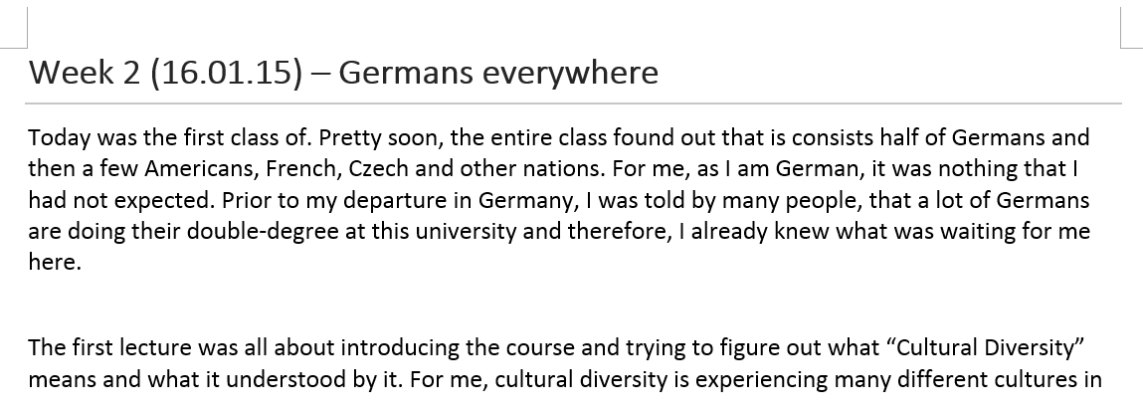
Case Study 1
‘Home’: physical move (yes), cultural move (no?)
Therefore, intercultural learning ‘unlikely’ (?)
Notes:
The above casts an initial doubt on the default assumption (Slide 3) that “intercultural learning takes place through overseas encounters with foreignness”

Slide 10
Case Study 1
Research questions (Case study 1)
Do these students encounter cultural otherness in this overseas ‘home’ context?
If so, how can their responses to that cultural otherness be understood in terms of intercultural learning?
Notes:
Questioning: the concepts of ‘foreign’ and ‘home’ (e.g. identification of comfort zones and experience of them being confronted)?
Cultural otherness defined in a non-essentialist way

Slide 11
Case Study 1
Joanna (Learning Journal, Week 2)
Throughout the lecture, the lecturer introduced us to the different views on “Cultural Diversity” and gave us some information on assessment etc. In my point of view, the lecturer, who is originally from China, was very formal and her lecture was perfectly prepared. I do not know, whether it is a culture thing, but she was very formal, always polite and her speaking was very calm. Those are just a few things that I noticed and believe to be typical for the Chinese culture. So this was my first encounter on that day with severe cultural diversity. As I already saw other lectures from different lecturers of different ethnic backgrounds I am not used to this very organized and formal way of teaching. For example, one other course is taught by a lady from India or Pakistan, and she was very euphoric during the lecture and kept on making jokes. It was just something very different to what I experienced today.

Slide 12
Case Study 1
Joanna (Learning Journal, Week 6)
In this weeks class, I felt frustrated. We talked about how someone can become intercultural and in addition to this, received some useful information about this learning log. When I looked at the material given to us, I felt angry. This was the kind of information we were all hoping for since week 1 and we all felt that we could have needed this for our log, in order to do it correctly from the beginning. The lecturer talked about the second assignment and how the learning log is needed for this assignment, but all I could think about was, that I still do not understand what the second assignment is truly about and how the learning log comes into consideration.

Slide 13
Case Study 1
Joanna (Learning Journal, Week 9)
This weeks group meeting was not as bad as expected but could have gone a lot more smoothly. In my opinion, Person A and I did all the work for the assignment, while Person B at least tried to contribute in this weeks meeting, whereas Person C contributed about 2 sentences to our assignment. Evaluating this makes me quite angry. Not only the fact that we were supposed to be finished by last week and we are more than one week behind schedule but also all the enthusiasm from the first group meeting is entirely eliminated. When we are together, it it’s a very tense atmosphere. In the first meeting it was all nice and happy and everyone was quite excited about the assignment. But now, everyone is annoyed and tries to stay calm while not jumping on another for not doing work properly. Once again, I am reassured that group work in assigned groups just does not work out properly. I have been asking around a lot in the course and every group states that they are having problems as some members are just not doing their work. Of course, I only asked my other German friends and they stated that their group members were quite lazy. Therefore, I am getting the impression, that it is indeed a culture thing. I do consider the German culture as very eager and precise in terms of work being done. I count myself toward this as well. I just believe that once a task is defined, one should just finish it properly and fast and then move on to the next task. That is just how I was raised and I do expect that from others as well.

Slide 14
Case Study 1
Julia (Learning Journal, Week 4)
We were supposed to work on different aspects of measuring about improvements in cultural competences. During that first work with my new group I had some private thoughts about my team members: I noticed that I immediately tried to unite each of them to someone I know with similar look, attitude or background. I haven´t noticed that before and maybe I just did because I was taking notes for the learning journal. However, I have to admit that I had emotional reactions to each person of the group after the first few spoken words. I was not thinking about that in a negative way but irritated as I was questioning myself if it is normal human behaviour interacting with others to make a mental connection to things or people known before even trying to get to know the new.

Slide 15
Case Study 1
Julia (Learning Journal, Week 7)
Unfortunately while writing this the day after the lecture, I am facing the first real problem within our group. After the lecture we agreed that everybody will look for examples for cultural trainings. E.g. funny videos, games, jokes, and most important: real training material. We intended to use this first in our written group assignment and later on for our intercultural training. I was looking through all the things my team members uploaded on our shared platform on Facebook and I was quite shocked. None of this seemed to be useful. I also questioned my sense of humour as I found some of it not at all ‘funny’ as it has been promoted by the person who uploaded it. I discussed my problem with my roommate. How can I tell another team member that not all of her input does actually fit our project? I worried about being rude. Following the advice of my roommate I tried to think about the situation as if it would be the other way around and someone would tell me the concerns about something I shared with good intentions. I noticed that I myself had not shared anything yet regarding our intercultural training. Discussing the problem with someone helped me as it forced me to talk through all the details in order to explain the situation to a third person. Afterwards I decided only to place a comment to those uploaded videos that I actually liked and to ignore the other videos and jokes and wait until the next group meeting. A personal explanation about my concerns seemed to be the better choice than writing something in an online group.

Slide 16
Case Study 1
Julia (Learning Journal, Week 7)
During preparation of tomorrows group work I got alert about a discovery I made that day. I noticed that one person in our group had provided access to our shared files to other students who are participating in the MCD class but are not part of our group. I know that there is a group of friends in our class which have been separated in the smaller groups for the course work. Therefore when I found out about the granted access, I was very concerned that our team member would expose our progress, especially with regards to the ideas we were collecting for our intercultural training. We were actually starting to make progress in our intercultural training and I was nervous. First thought that came to my mind was to tell my concern to the group. Then I thought this would be a very ‘German’ thing to do, like it would look like I am spying on my team mates and distrust them. Because of that I wanted to talk to the other German in the group. I felt a connection because during recent group meetings I noticed lots of similarities in the way we both work and react to certain situations. I was afraid to seem distrusting people. At the end I concluded that it is better sometimes to keep my thoughts to myself . I wrote my thoughts to this topics in the learning journal and decided to wait until the next group meeting.
Notes:
In the spirit of researcher dialogue, let’s now look at a very different case study, which nonetheless also has the potential to reveal something about intercultural learning at ‘home’.

Slide 17
Case study 2: Sephardim in Bulgaria
Narrative study of elderly Sephardim in Bulgaria regarding their Ladino-based identity.
Oral history -> intercultural study
14 storytellers, the eldest = 93
Languages used: Bulgarian, English, Ladino
Identity performance (narratively and interculturally)
Zones of interculturality

Slide 18
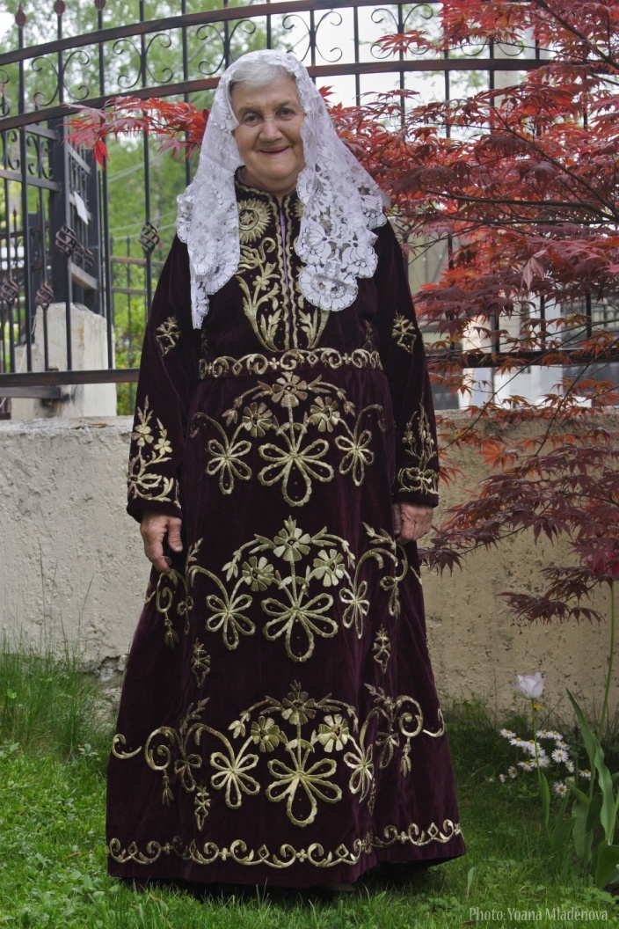
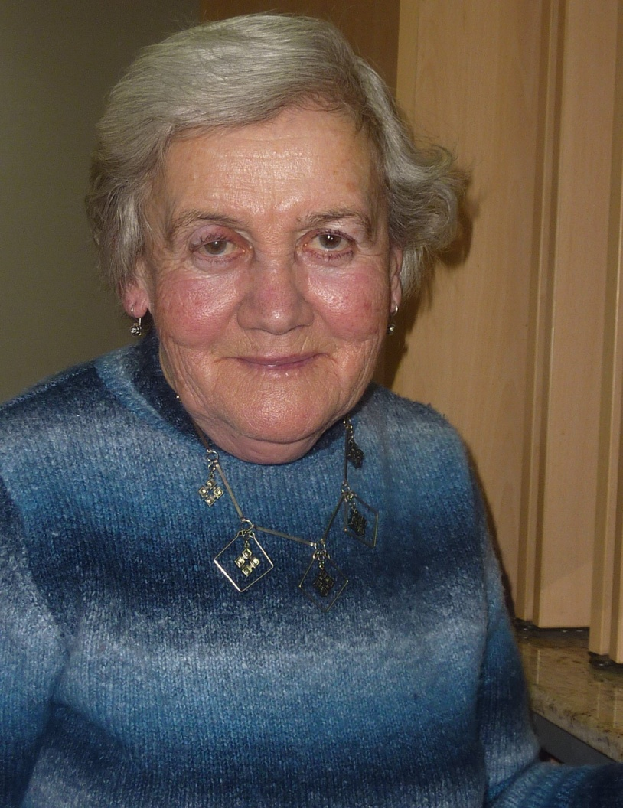
Reina Lidgi

Slide 19
Insights
the intra-, inter- and trans-cultural activities that the members of the diasporic Sephardic community in Bulgaria have engaged in and continue to engage in drawing upon their resources in Ladino
interactions enabled by their multilingualism and especially their main language of cultural affiliation – Ladino
interactions within and beyond their home society in Bulgaria and beyond

Slide 20
Main research outcome: five zones of interculturality
the (intra-)personal --- a zone of internal dialogue;
the domestic --- a zone for the family
the local --- a zone for the Sephardic community in Bulgaria;
the diasporic --- a zone for the wider Sephardic community; &
the international --- the international community of Spanish-users.
As set against the historically-, politically-, culturally-, and societally- changing Bulgarian Sephardic Jewish Ladino-oriented context(s)

Slide 21
My sense of being an heir to this language is special. It enthuses and empowers me with a kind of primary and fundamental force … We seek our sense of uniqueness and find it in this language. It is a symbol, a token of our otherness. [Andrey]
… my Grandma moved in with us. […] She could not speak Bulgarian and she took it upon herself to teach me Ladino. She must have been a good ‘teacher’ … in less than three months, I was able to communicate with her in Ladino. I don’t think I could fully understand everything but we somehow managed to talk with each other. [Reina]

Slide 22
3a. In Plovdiv, my father used to go to the Jewish club every day. He played cards with his friends. All their jokes, curses and playful bantering were done in Judesmo. [Eli]
3b. A terrible pressure for integration was exerted, both from the inside and from the outside. I grew up in the Jewish neighbourhood where we spoke Bulgarian with a distinctive accent. [….] We did not like sticking out like this and did our best to get rid of the accent - so that nobody could tell. [Aron]

Slide 23
4a. In Jerusalem, I set out to see the Holocaust museum. As it was closed I wanted to find out about the working hours and came across a man from Egypt who spoke Spanyol. When we finished talking he said to me, “If you walk a bit further, you’ll find another guy who can also speak Spanyol.” [Sami]
4b. I’ve come across people from other Sephardic communities […] I met a Jewish guy from Cuba once. We spoke and our conversation resonated with something deep inside me and we both felt we belonged together. [Solomon]

Slide 24
5. Have you ever heard Cubans speak Spanish? They tend to swallow their consonants and it’s hard to understand them. For a whole week I kept my mouth shut and did not dare speak. By and by, I gathered courage and would put in a Ladino word here and a word there. […]
The response of the Cubans was twofold. First, they thought they heard somebody who had risen from their grave. So obsolete was the language I produced. They were enormously delighted and would make me repeat what I said, time and time again. [Aron]

Slide 25
Researcher dialogue
Viv | Richard
overseas ‘home’ context | 'home culturally complex context / 'home' diverse context
intercultural learning reflections | intercultural living narratives

Slide 26
Researcher dialogue
Dialoguing 1: Bearing in mind Richard's case study, might the sense of narratively performed intercultural identity be generative for Viv in terms of reflectively/reflexively performed intercultural learning?
Dialoguing 2: Bearing in mind Viv's case study, might the sense of a home cultural context nested within a larger different cultural context be generative for Richard in terms of a home cultural context (Sephardic) nested within a larger different cultural context (Bulgarian-Bulgarian)

Slide 27
Researcher dialogue
Our intercultural dialogue has a critical orientation (Pennycook, 2010):
By asking such questions, we are beginning to a) problematise some of the taken-for-granted methodological and conceptual aspects of our studies; and by doing so b) reflecting on the relationship between our researcher practice and theorising
Therefore a critical perspective of viewing our dialogue on different aspects of our work.

Slide 28
Thank you!
Xiaowei: v.zhou@napier.ac.uk
Richard: richard.fay@manchester.ac.uk

Slide 29
Critical Applied Linguistics
Pennycook (2010) …. CAL is
“more than just a critical dimension added on to applied linguistics; it involves a constant skepticism, a constant questioning of the normative assumptions of AL ….” (p.10)
the constant “problematizing of givens” (p.7-8).
the “constant reciprocal relation between theory and practice” (p.3).
the centrality of “social responsibility and social transformation” (p.6).

Slide 30
Researcher dialogue
we are both doing the following, and we do we get out it?
Problematising the givens (cultural = national; home and foreign)
Reflecting on the practice of being intercultural (Viv: on the intercultural learning in a ‘bicultural’ classroom; Richard: on the intercultural living evident in the five zones of interculturality)
Social transformation (Viv: seeking to enhance students’ ICC – add …; Richard: learning from the storytellers about earlier eras of interculturality; problematizing national identity)

