Slide 1
Indonesian English Language Teaching Post-International Standard School (ISS) Era: A Case Study at an ex-ISS school in Indonesia
S. M. Fitriyah
School of Education
University of Manchester

Slide 2
What is ISS?
International Standard Schools or ISSs are public schools that have complied with Indonesian National Standard of Education and enriched by a unit of excellence of one of OECD members or other developed countries. The aim is that the graduates are capable of being more internationally competitive.
MoNE of Indonesia (2009)

Slide 3
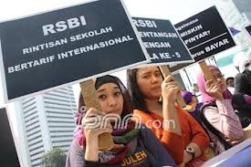
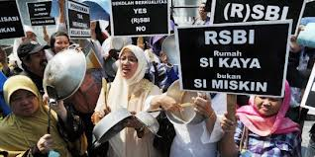
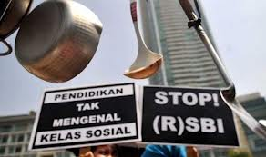
Rally against ISS

Slide 4
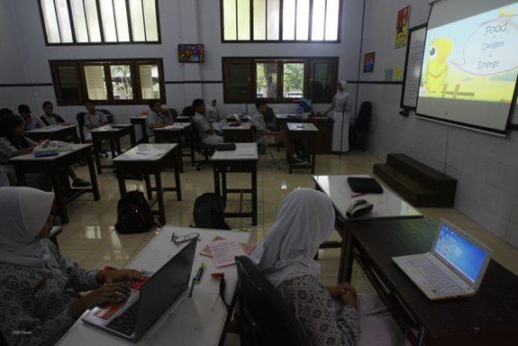
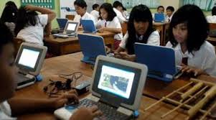
ISS images

Slide 5
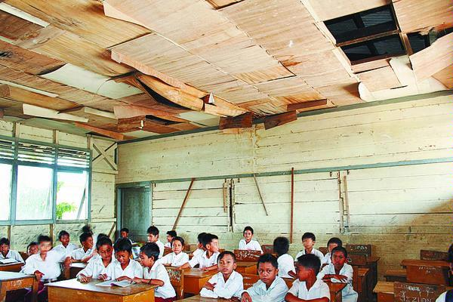
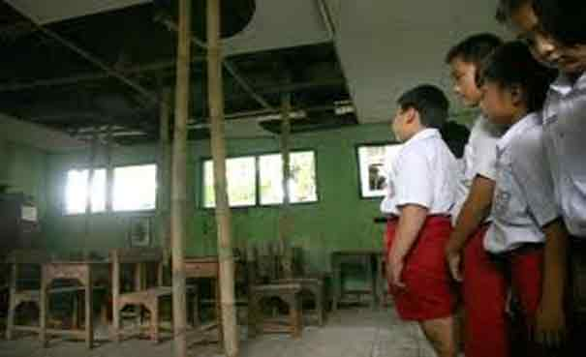
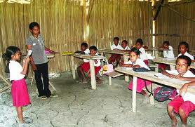
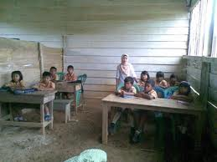
Poor Schools

Slide 6
ISS - Milestones
2003
Chapter 50 Act no. 20 about National Educational System- Legal basis of ISS implementation
2006 – ISS started to be implemented with Pilot ISSs
December 2011 - Judicial Review field by a Teacher Union and an NGO
January 2013 – CONSTITUTIONAL Court annulled the laws supporting the implementation of ISS

Slide 7
REASONS FOR ANNULMENT
ISS – violation of state obligation to provide education for all
ISS – educational dualism (high quality – low quality)
ISS – a new form of liberalism of education (education is no longer free)
ISS – discrimination and emergence of ‘school caste’ (rich school vs. poor school)
ISS – a threat to national identity (violating Indonesian Pledge of Youth of Indonesian founding fathers ‘With one language – Bahasa Indonesia’) – English becoming the central issue
Constitutional Court OF RI (Verdict No. 5/ PUU-X/2012)

Slide 8
Why English?
Although English was not specifically mentioned in the definition of ISS, it becomes primarily important and is the most prevalent characteristics of an ISS.

Slide 9
English in ISS School
Science, Math, and ICT were taught in English – English as a medium of instruction / CLIL
CLIL teachers got intensive English training
Students got intensive English Training
English Environment
Parental Support
School Support
Regional and National Support (funding, English competition, etc)
Students and teachers seemed motivated to learn and use English both in the class and around school.

Slide 10
Problems concerning English during ISS
CLIL Teachers English proficiency – very low (Coleman, 2010)
English often becomes barrier for learning for the students (www.indonesiaeducate.org)

Slide 11
ELT Post ISS ??
English was one of the reasons for ISS Dismissal
No more emphasis on English
Any Consequence??

Slide 12
What Educational Reform can do?
“Reform is not just putting into place the latest policy. It means changing the cultures of the classrooms, the schools, the districts, the universities, and so on.” Fullan (2001, p. 7)

Slide 13
A Case Study
Aims: to explore how the Indonesian educational policy change, that is the dismissal of ISS may affect:
- Indonesian policy on ELT
ELT in practice
ELT teachers’ perception and praxis
students’ motivation and experience in ELT
parents’ support towards ELT
and head teacher’s support towards ELT
Notes:
Too large?? Seemingly. Focusing on teachers’ and students only?? Can be but the data would be rich. Wait for feedback.

Slide 14
Research Questions
How does the dismissal of ISS influence Indonesian policy on ELT?
How does the dismissal of ISS influence ELT teachers’ perception and praxis on teaching English?
3. How does the dismissal of ISS influence students’ motivation to learn English?
4. How does the dismissal of ELT influence students experience in learning English?
5. How does the dismissal of ISS influence parents’ support for their children to learn English?
6. How does the dismissal of ISS influence head teacher’s support on ELT in his/her school?
Notes:
e.g. methods of teaching, hours of teaching, use of English in the school.

Slide 15
Data generation Method
documentary analysis
narrative interviews – teachers, students
semi-structured individual interviews – head teacher, parents
group interviews - Students
focus groups – teachers

Slide 16
Data Analysis Method
narrative analysis
discourse analysis
thematic analysis
Notes:
Too many?? Can be

Slide 17
Any questions and suggestions??
Thank you ☺

