Slide 1
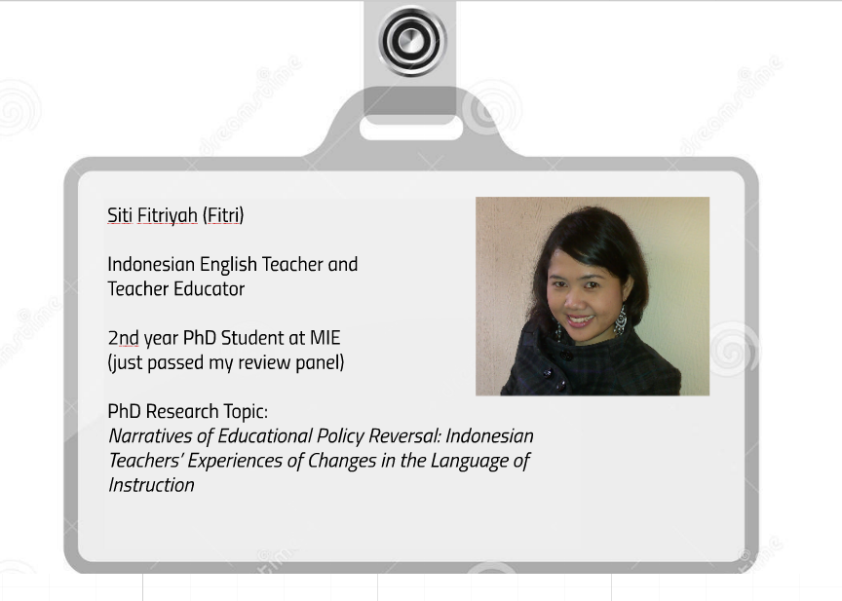


Slide 2
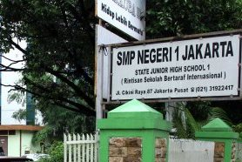
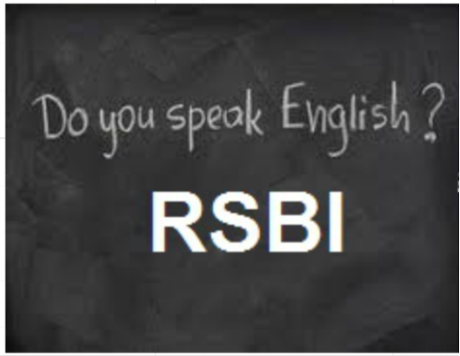
The Introduction of Indonesian Interdisciplinary Curriculum
International Standard School
(ISS/ RSBI)
(2006)
English-medium Mathematics and Science Instructions
(EMI/ CLIL)
Reverted in 2013

Slide 3

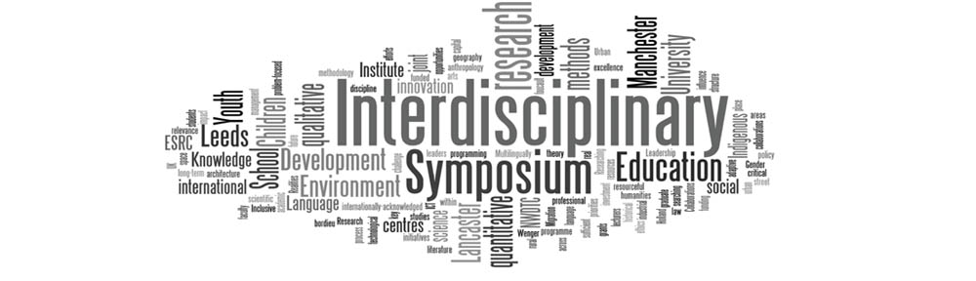
Based on the initial phase of my study (Pilot Study)

Slide 4

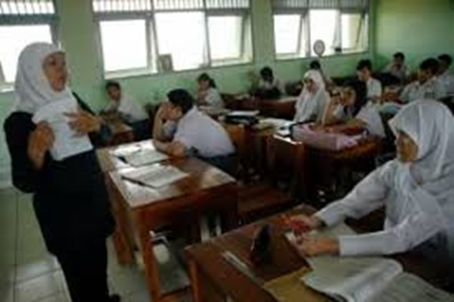
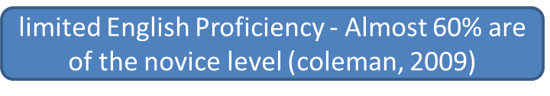
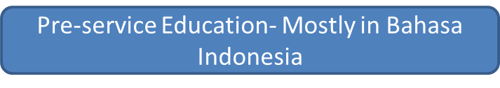
EMI/ CLIL Teachers
European Commission (2012), Hansen-pauly (2008)
Uys, et.al., 2007; Marsh, 2006; Kyeyune, 2003
(MoNE, 2009)

Slide 5
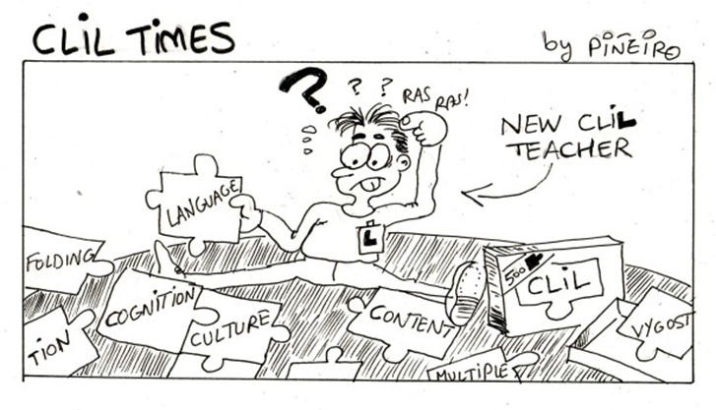

Slide 6
Challenges to learn English
‘We prepared ourselves by learning from colleagues, especially the English teachers…and also with the lecturers from the university…It was not as easy as what we imagined, because of our limited time and English proficiency, we developed really slowly’
‘I was scared because of the language challenge. I did not like English at the time. I felt English was really difficult’
Excitement to learn English
‘Teachers and students alike were really motivated to improve their English proficiency, and the efforts to keep up with other countries had been on the track by the use of English in the lessons’

Slide 7
Challenges of using English in the classes
‘I used English only for opening and closing my lessons. During my lesson, I use English only for asking the students to do something, or other sentences which were not part of the materials’
'If we use full English, we will get it difficult, because both the teachers and the students had passive English’
Teachers’ Limited English Proficiency
‘…some other teachers seemed to have problems with English and even often asked the students to translate the exercises from Bahasa Indonesia to English’
Mismatch Between Training and the required skills
“We learned TOEFL and sat for a TOEFL test”

Slide 8
Diminishing Pride of Speaking National Language
‘…but on the other hand, I feel that in the long run we are more proud to speak…I feel that gradually our love to our own language will be fading…’
International Cooperation
‘ We had a partner school abroad to which we sent some of our students to learn for sometime’
‘we used to have a sister school program, a cooperation with a school abroad’
Students Achievements
‘some of our students represented our province for National Science Olympiad in Batam. We had silver medals for Biology’
‘My students sat for ICAS Australian International Assessment for schools, and some of them has very good scores’

Slide 9
Teachers have more Language Challenges
Many students seems to have passed the language barrier (good achievements)
The excessive use of English might affect students national identity
The program was challenging, yet motivating both students and teachers to do more

Slide 11
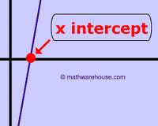
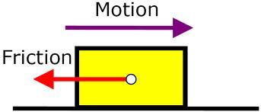
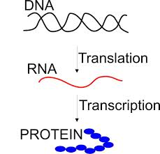

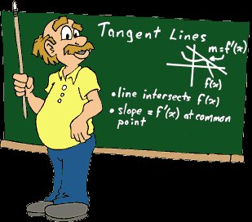

Technical Terms
Events that I am not familiar with (Exams, Competitions, etc)
TPD Foci and Activities

Slide 12
Being an Interdisciplinary Researcher
Be prepared with the unknown
Prepare the amo to go cross the bridge
Learn more about the other part of the river

Slide 13


