Slide 1


Exploring participants’ changing perspectives through the life of an inter-school, collaborative, research and development project
Lantern Lunchtime Talk
29th April 2016
Ellen Wilkinson Building
Andy Howes
Sue Goldrick
Susan Dawson
Volha Arkhipenka
Siti Fitriyah
Nahielly Palacios

Slide 2
Introduction to CRS (Sue)
Working with teachers in context to develop an equity steer and an enquiry stance
Based on 20 years of experience
Framework of cross-school workshops and in-school developments

Slide 3
Collaborative enquiry
Ongoing search for increased understanding of how to support students’ learning
Starts by asking questions
Allows for a range of possible outcomes
Mediated through dialogue

Slide 4
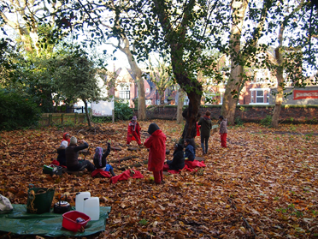
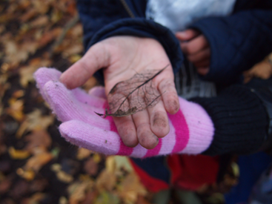
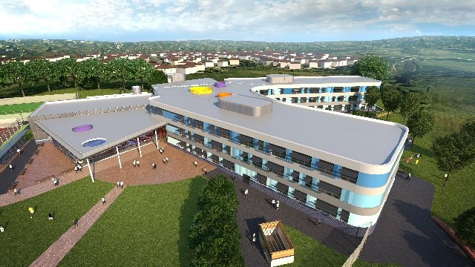

Slide 5
Roles within CRS - GRA(Fitri)
Attending meetings with teachers and CRS team
Assisting with Literature Search
School Visit: Assisting with Data Generation
Assisting with Transcription
Assisting with Data Analysis
Assisting with dissemination (e.g. Poster)

Slide 6
Experiences within the team (Nahie)
Sharing Reflections
Collaborative Thinking
Collaborative Research (RQ, methods, instruments, etc.)
Collaborative Paper Writing (CRS team)

Slide 7
Theoretical Framework- Andy
A practice such as teaching is a richly layered activity, deeply connected into identity. To develop practice is to systematically extend oneself and one’s capacity, often with others (MacIntyre, 1984)
Performance is an aspect of practice highlighted in accountability systems, and involves a demonstration of the value of activity to others not engaged in that practice.

Slide 8
Methodology (Q-sort) -Andy
Q sort facilitates a flexible but structured approach to generating qualitative and quantitative data on complex subjective structures like opinions, attitudes and values (McKeown and Thomas, 2013)
Finite diversity of constructions
(Stainton Rogers, 1995)

Slide 9
Qsort initial results
There are four factors (groups of participants sorting similarly)
Including JMP, LOH, NMP: This is a research process; we don't know the answers; the project is contributing to school dev; we have time for this
Including ELB: This project is raising questions about our practice; focusing on what we don't have answers to is useful; finding time for this is challenging; there have not been any disappointments
Including CHB and KBR: the project helps bring groups of people together; I value the collaborative nature of the project; working with other staff is of mutual benefit; there have been some disappointments
Including PMP: the project involves people not usually involved in this way; it doesn't increase my motivation; it isn't really about understanding what's going on; there have been some challenges in this project

Slide 10
Case Study 1-Susan and Sue
Context: Mountain Pine School
Nikki and her team
Restorative
Justice
Team teaching
Role Play
Good behaviour?
Bad behaviour?
Behaviour
Emotional Intelligence

Slide 11
Turning Point
I think something that I have learnt personally is that, at the moment our project is about understanding the problem rather than trying to solve it, and that’s been a big turning point for me, cos I came in with the attitude of, so what’s going on, we need to fix it, and that’s what I’ve learnt so far, at the moment its about stepping back, … and trying to understand what’s happening.

Slide 12
Self-discovery
just by observing behavior, and how I interact with them, it’s hit a few home truths back to me of, how I deal with behaviour because I would have said, that I’m very positive and that behaviour management was a strong point, but there’s certain children that I’m realising that actually, my behaviour management, is not what I would have hoped it would be

Slide 13
‘knowing’ vs ‘doing’
‘they’re things that I’m sure as practitioners we all know, that positivity works better, you need to give the child time to calm down, and its things that seem really obvious, but we’re seeing that actually, its not always happening and I think that’s been quite surprising’
‘then what we started talking about was, what is it that happens to us, as teachers, that gets us to that point where we no longer feel we can, keep it together’

Slide 14

Case Study 2 (Andy and Volha)
Context: Blue Creek School
Mark, Emily and Carol
Needs to be improved!
Attendance

Slide 15
Turning point
Mark in response to ‘we think we know the answers, and we just need to find the evidence’
“so that is where I started off, when the project started that’s exactly what I thought, which became, I don’t know any of the answers”

Slide 16
Exceeding expectations
“And I think it had a bigger impact than I thought in terms of community, which I was not really expecting because for example the ‘walking bus’ in the morning is lovely. We have a real buzz walking bus in the morning. There are loads of people in the area now who every morning pass the same points and we see them. So they will join us and that made a difference. We are a visible part of community. Very visible”.

Slide 17
Excitement
“I actually quite look forward to meeting with Mark. Because I feel like we are really getting somewhere, and it is exciting, and I feel like it’s using my brain in a different way to everyday you know.. like repetition of things like children being sent and behaviour. These are kind of things that I know are going to happen in my day whereas this is a chance when we stop and we go “Uhh! Yeah! Okay! Brilliant! Let’s try this! Let’s go that way!”

Slide 18
Cautious voices
“So I wasn’t sure whether it will raise attainment. It depends on how we measure attainment. And are we talking for individuals or are we talking about school?”
“It says my students are likely to benefit from this and mine are not really on the walking bus. They are too little. So it’s not going to impact everybody. So there are children that it won’t impact.”

Slide 19


Reflections on the collaborative process (everyone)
Notes:
Nahie thinks that it would be great to put a picture to represent our personal reflection on being part of the project (Her choice of picture ‘collaboration’, and Fitri (writing academic paper), please kindly add a picture of your choice)

Slide 20

Notes:
We (Nahie and Fitri) created this wordcloud special for this occasion with us and our audience in mind ☺

